Slide 1
To do (updated on 3/5)
Confirm color
Update last slide
Save all as image
Create gif
Figure out how to save mp4

Slide 2
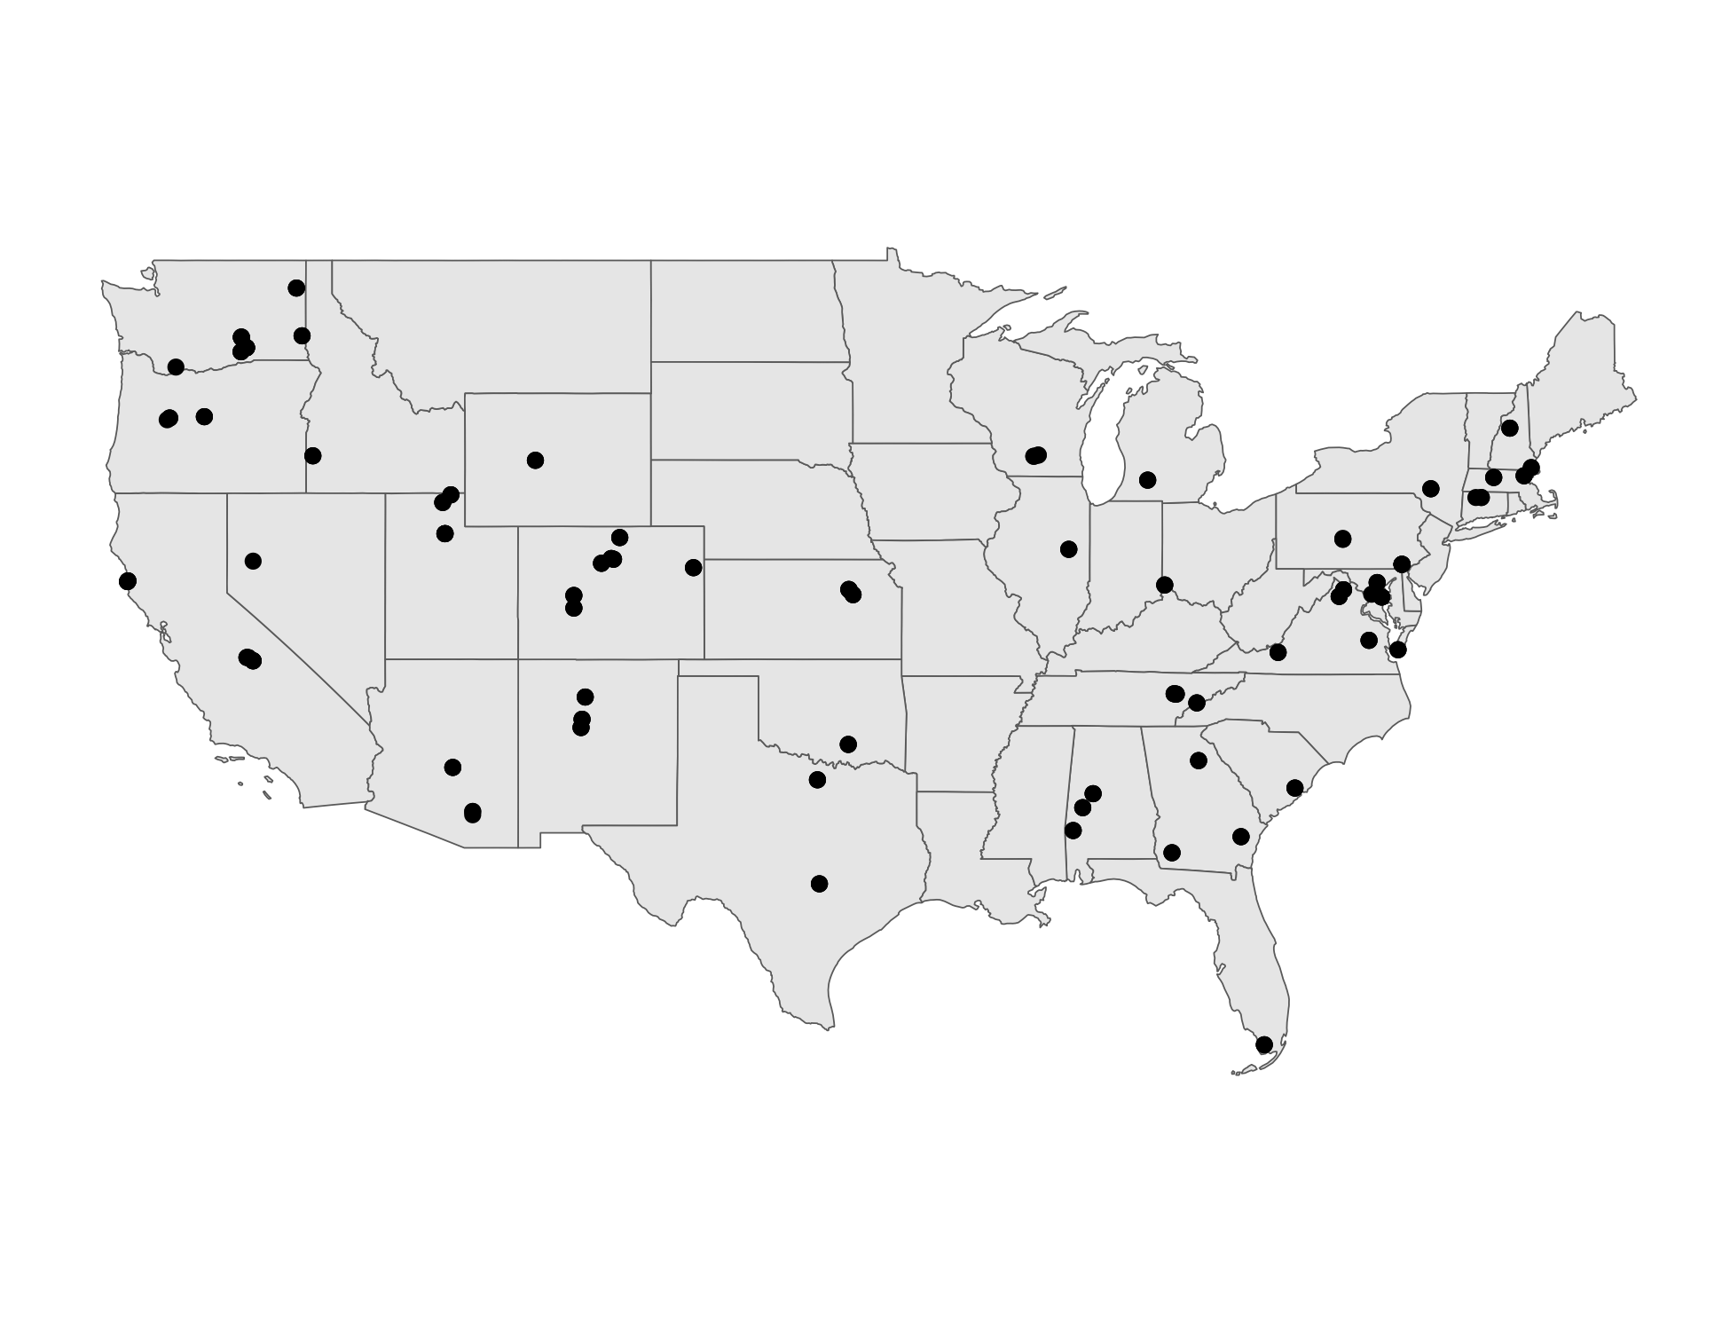
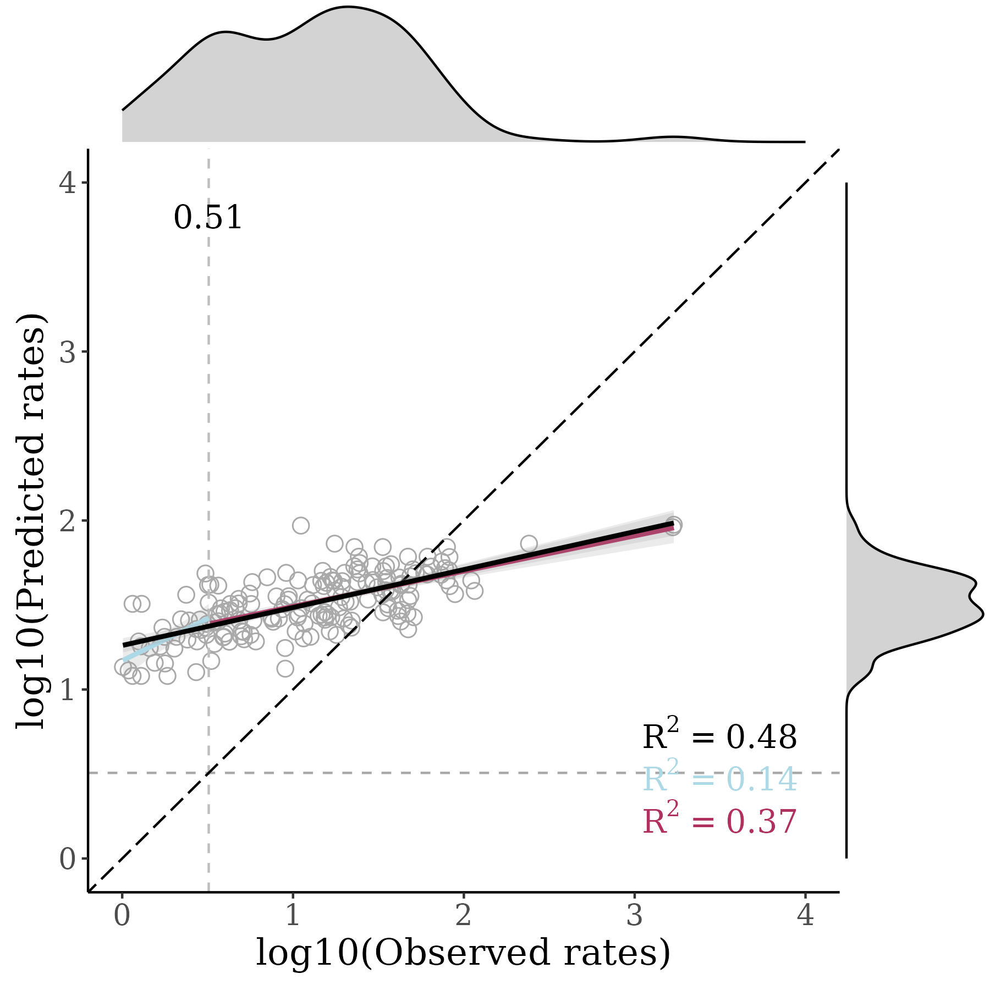
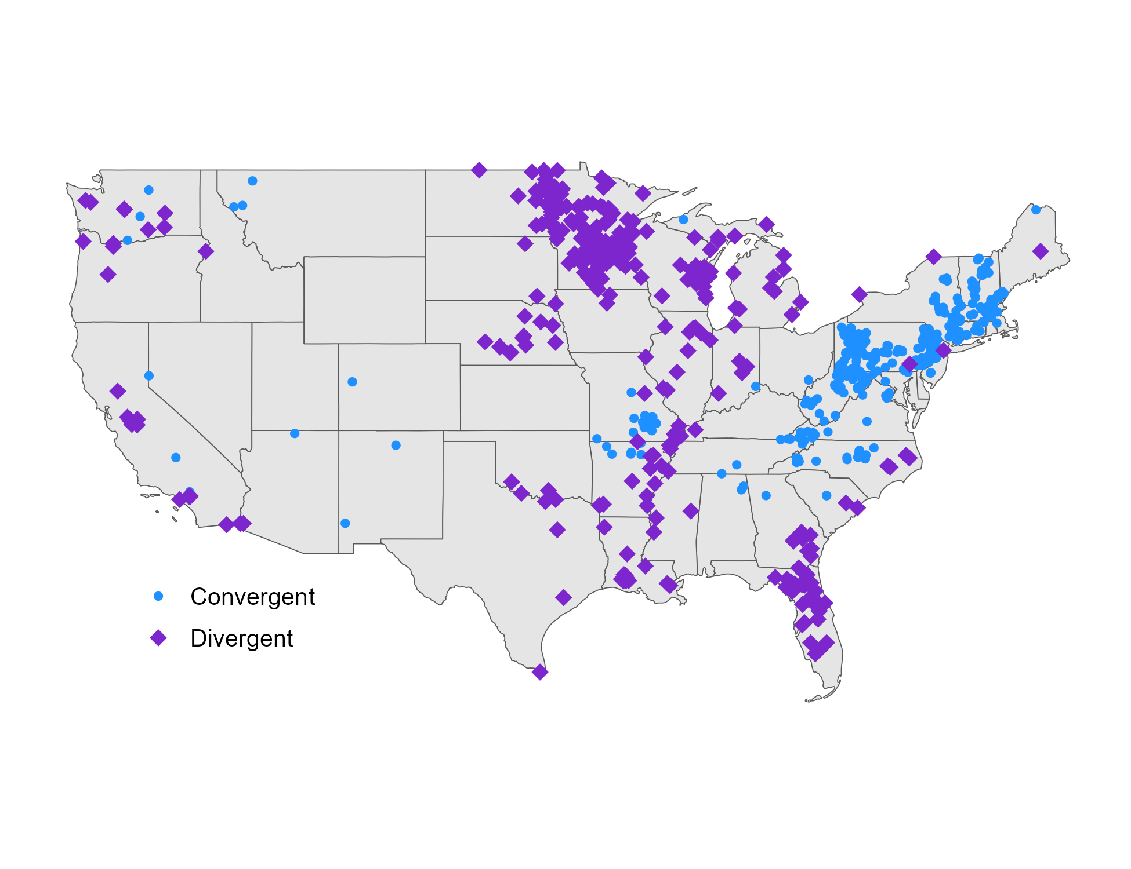
December 2021
a
SAMPLED SITES
MODEL PERFORMANCE
HIGH PRIORITY SITES

Slide 3
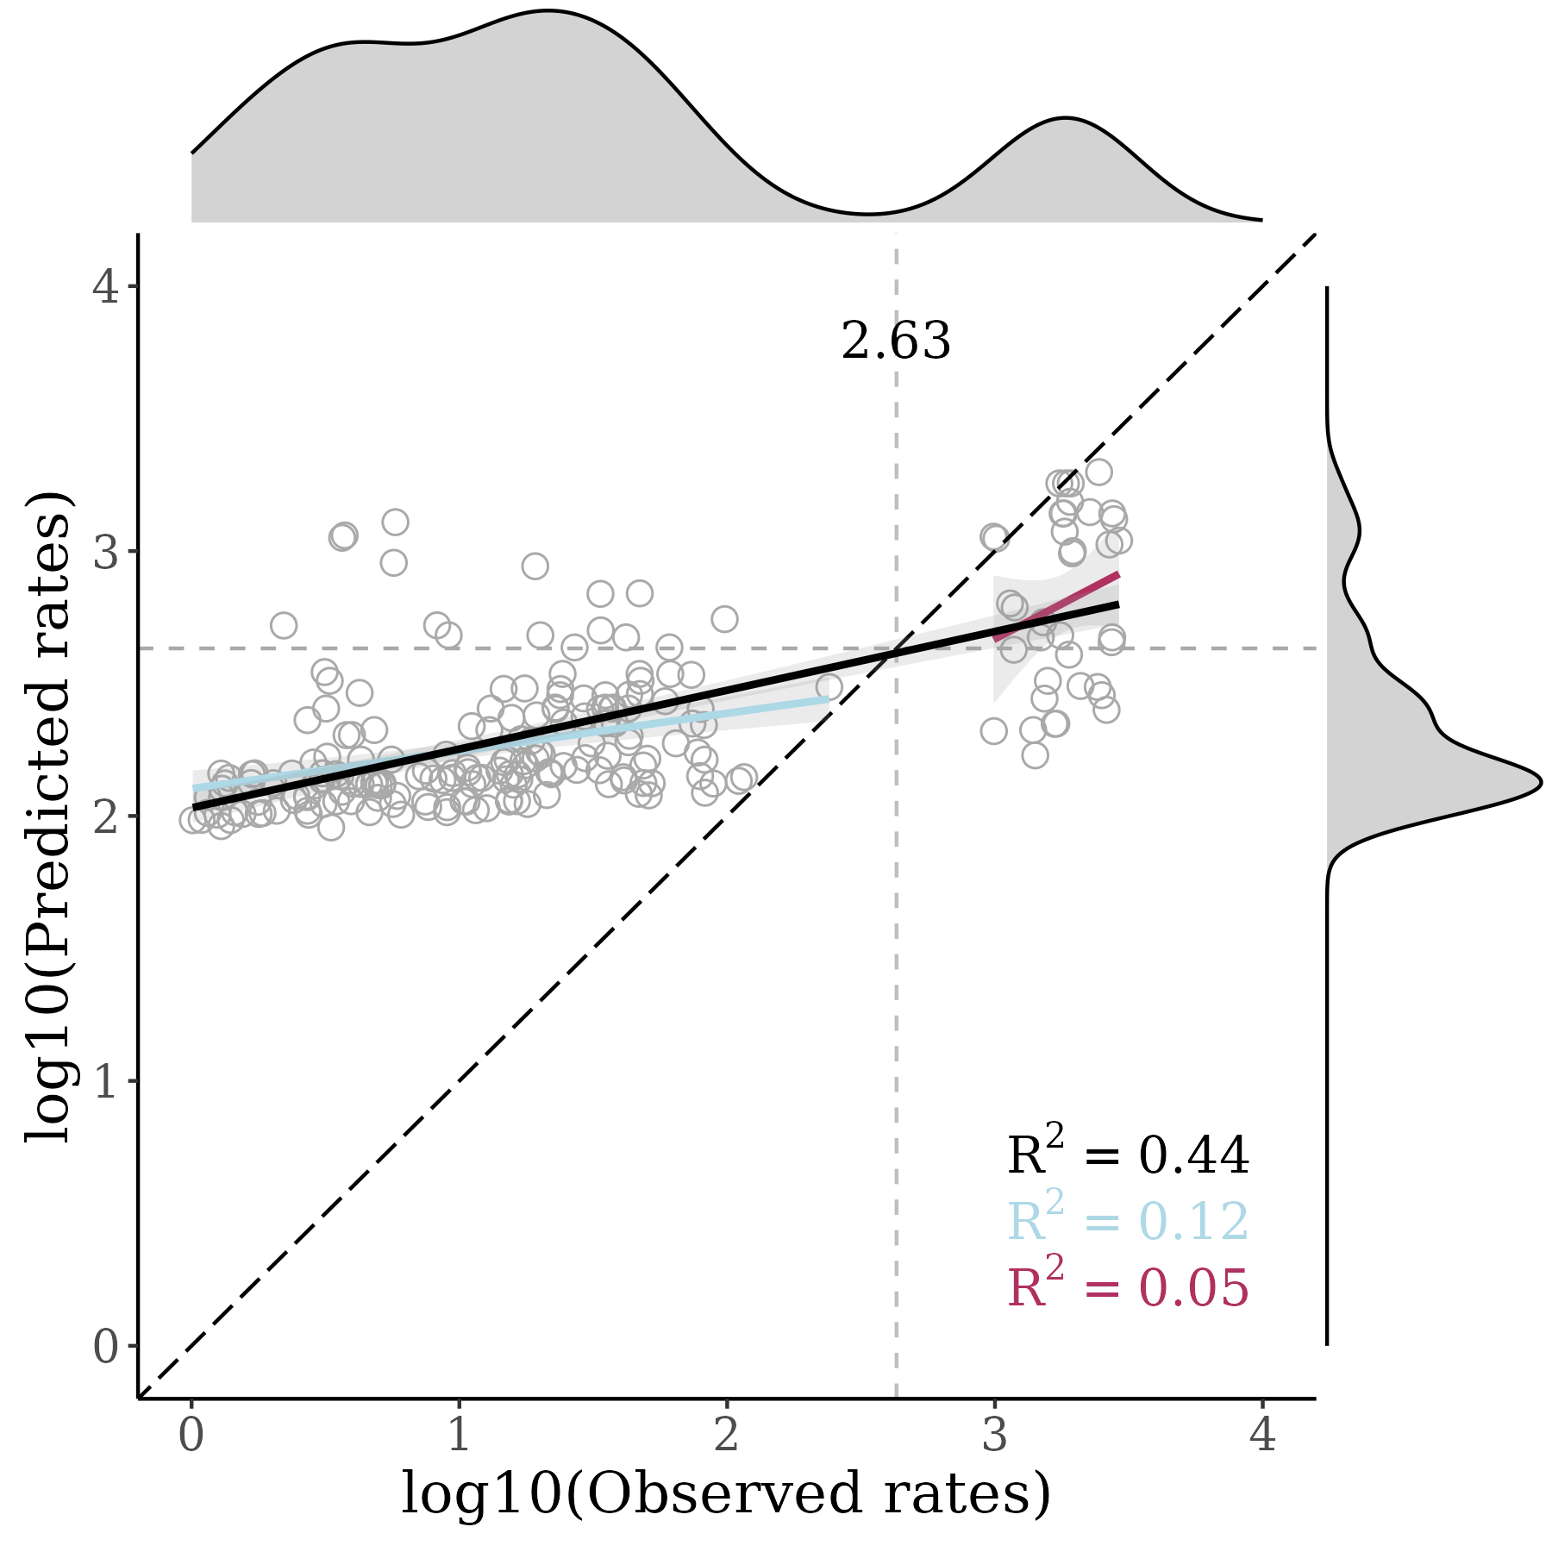
December 2021
b
SAMPLED SITES
MODEL PERFORMANCE
HIGH PRIORITY SITES

Slide 4

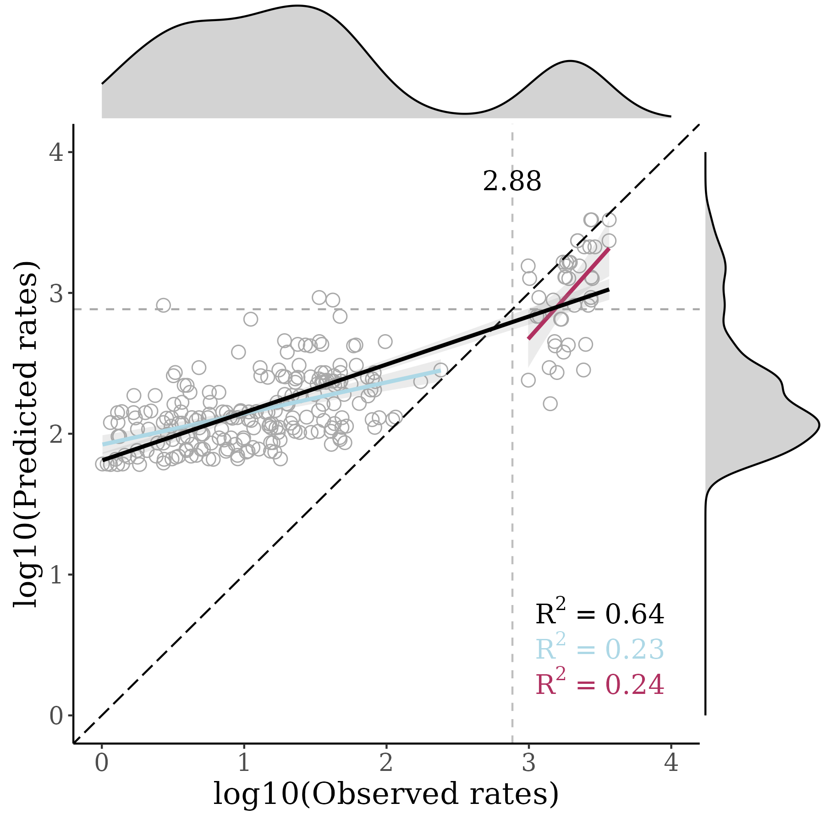
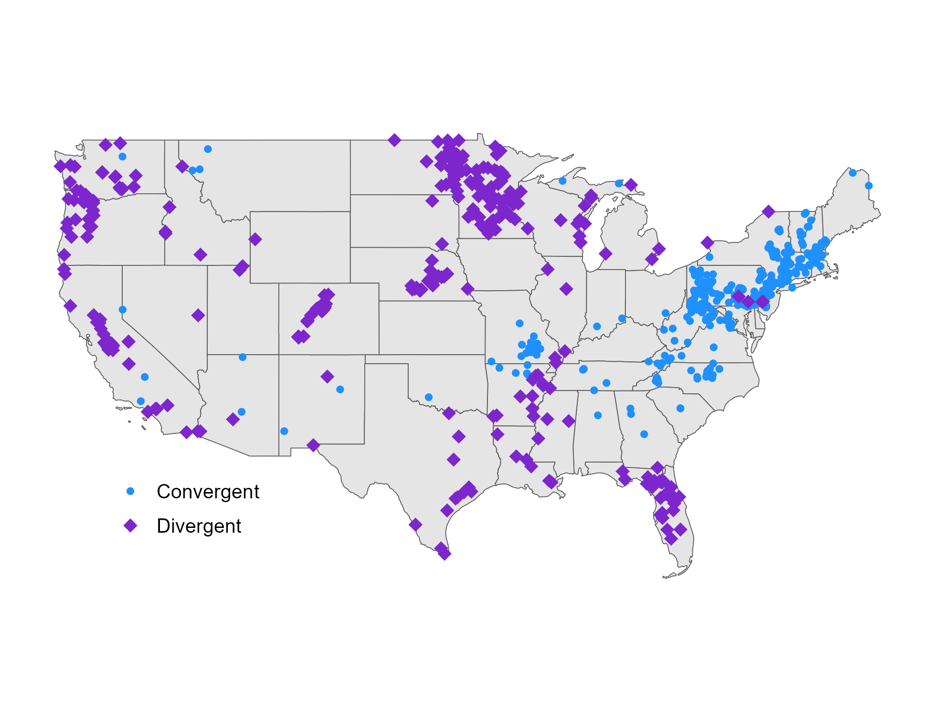
July 2022
SAMPLED SITES
MODEL PERFORMANCE
HIGH PRIORITY SITES

Slide 5

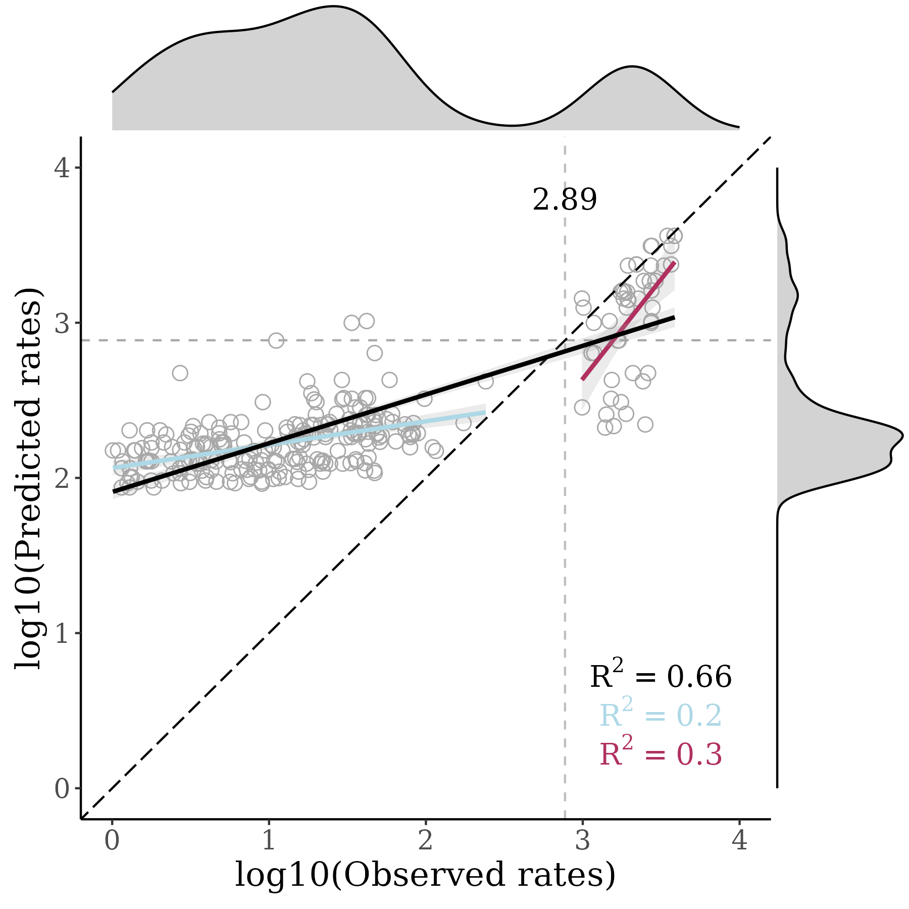

August 2022
SAMPLED SITES
MODEL PERFORMANCE
HIGH PRIORITY SITES

Slide 6

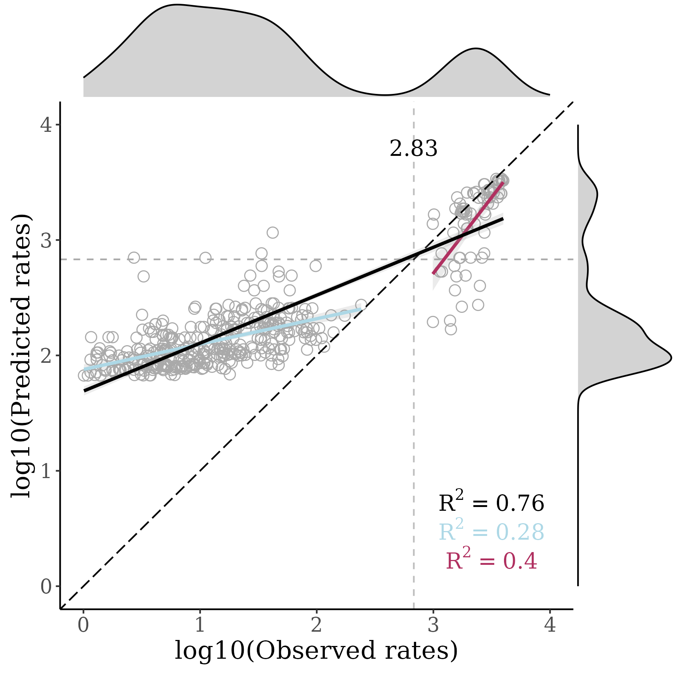
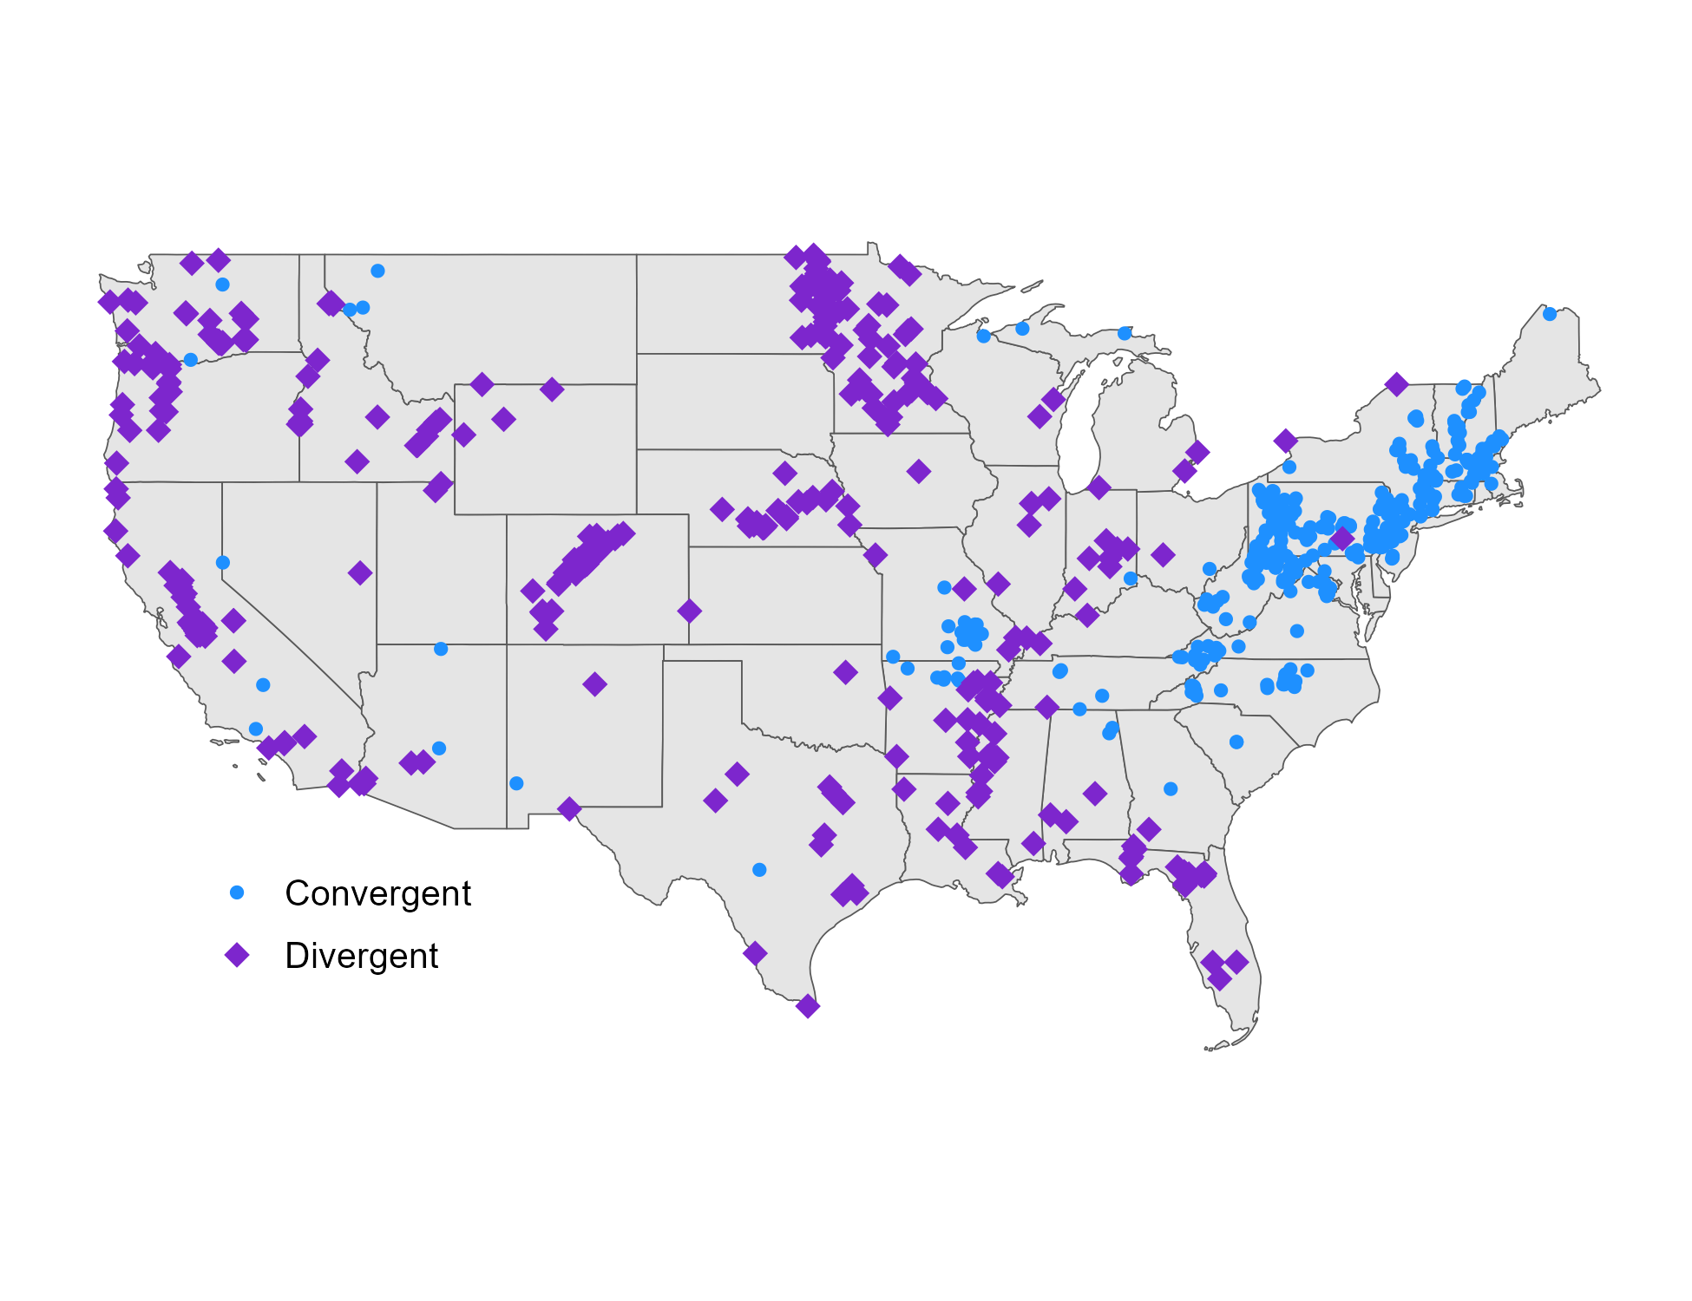
September 2022
SAMPLED SITES
MODEL PERFORMANCE
HIGH PRIORITY SITES

Slide 7

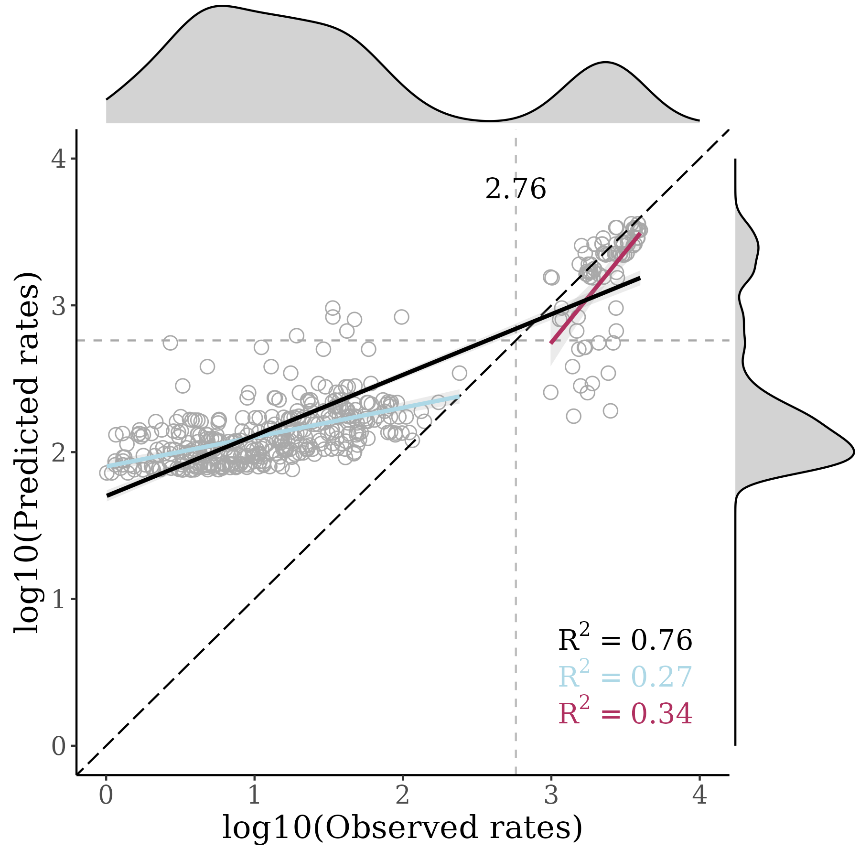
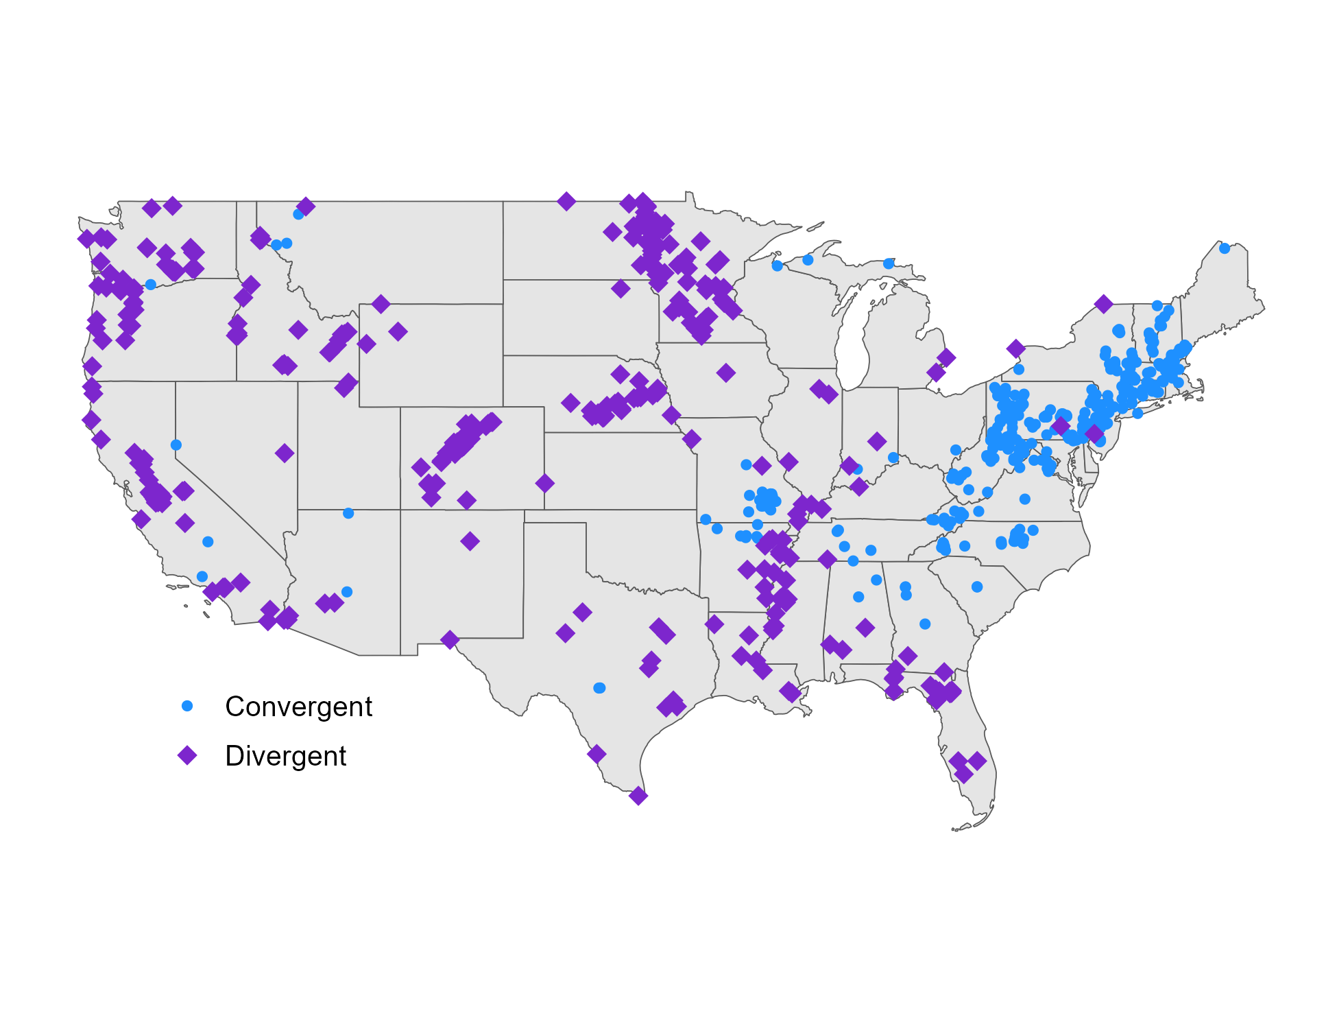
October 2022
SAMPLED SITES
MODEL PERFORMANCE
HIGH PRIORITY SITES

Slide 8

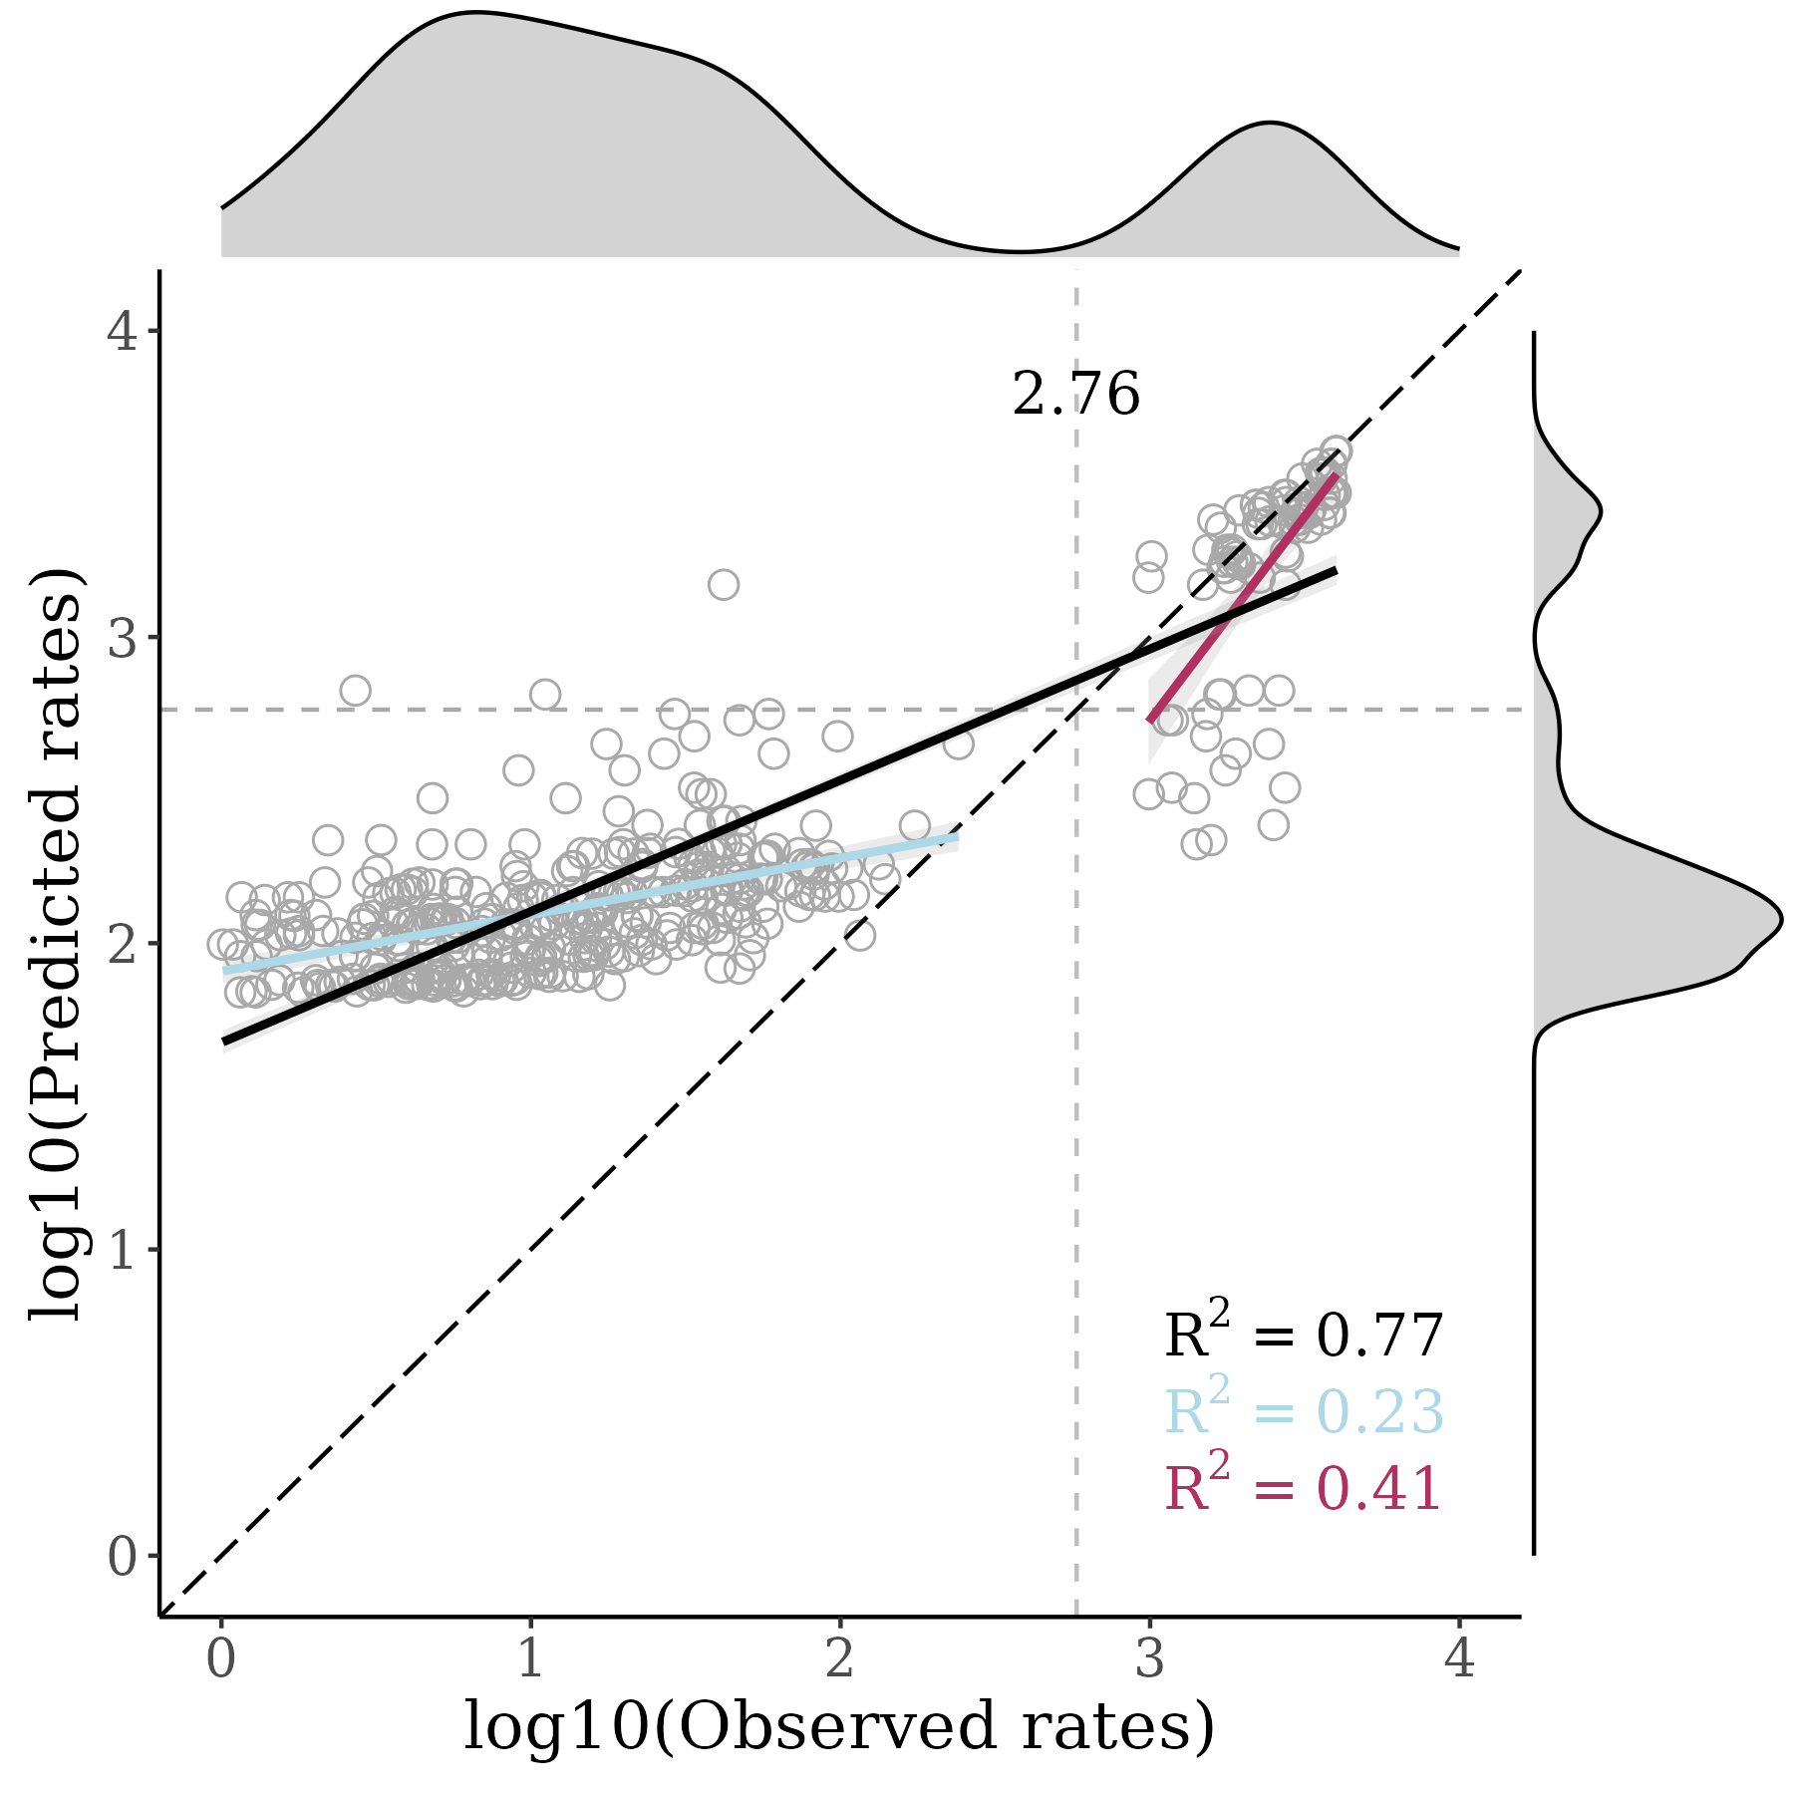
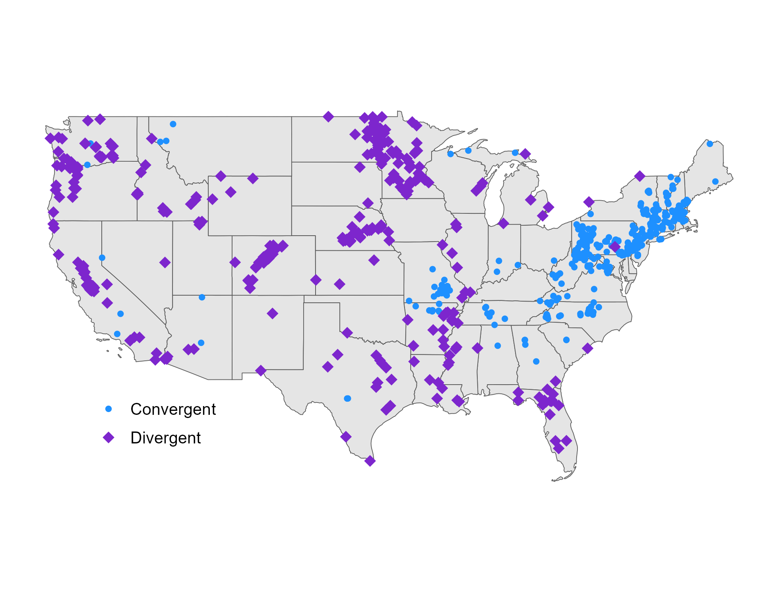
November 2022
SAMPLED SITES
MODEL PERFORMANCE
HIGH PRIORITY SITES

Slide 9

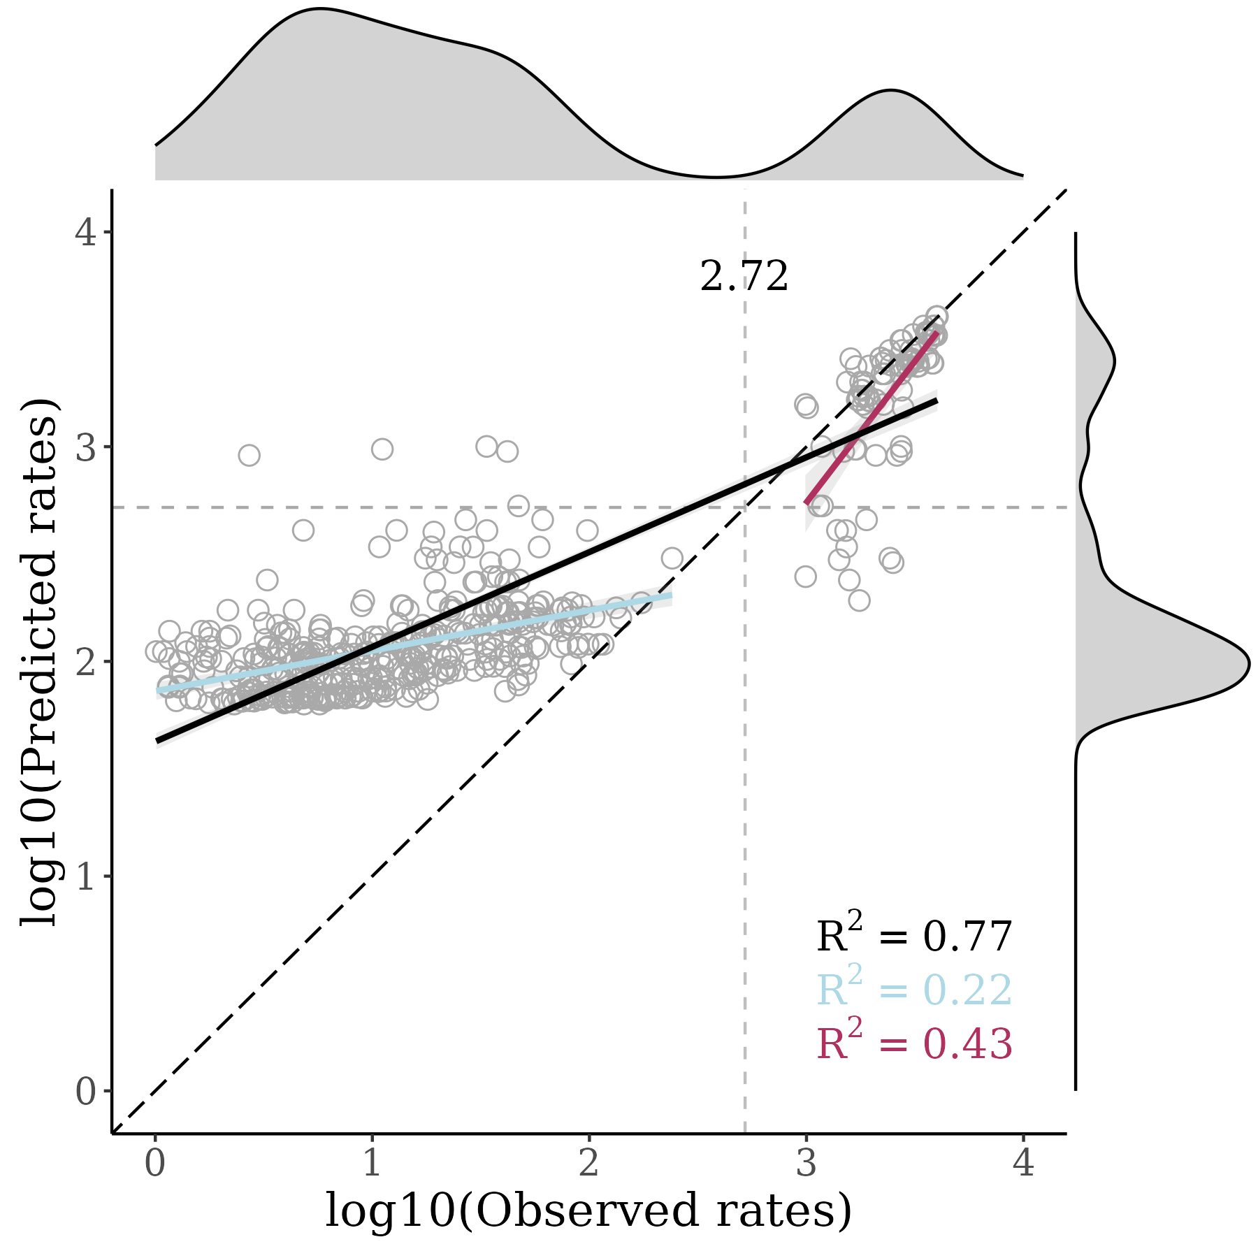

December 2022
SAMPLED SITES
MODEL PERFORMANCE
HIGH PRIORITY SITES

Slide 10

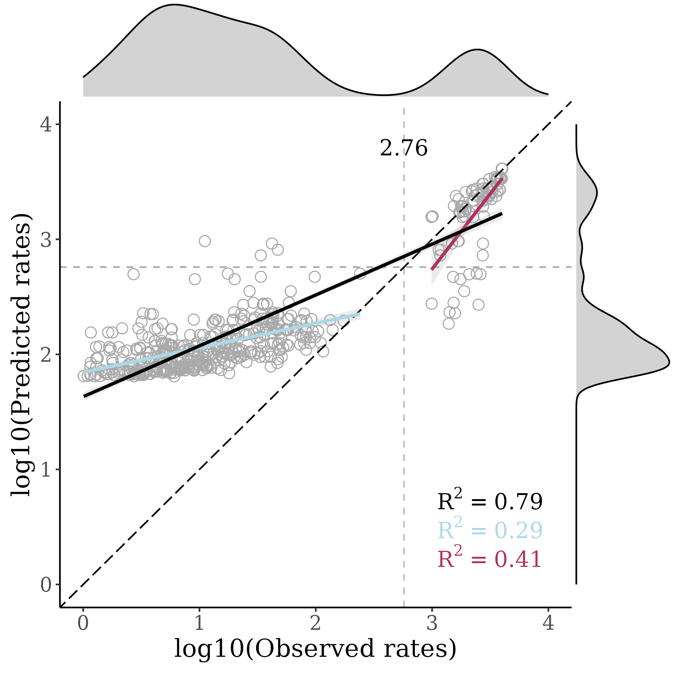

January 2023
SAMPLED SITES
MODEL PERFORMANCE
HIGH PRIORITY SITES

Slide 11

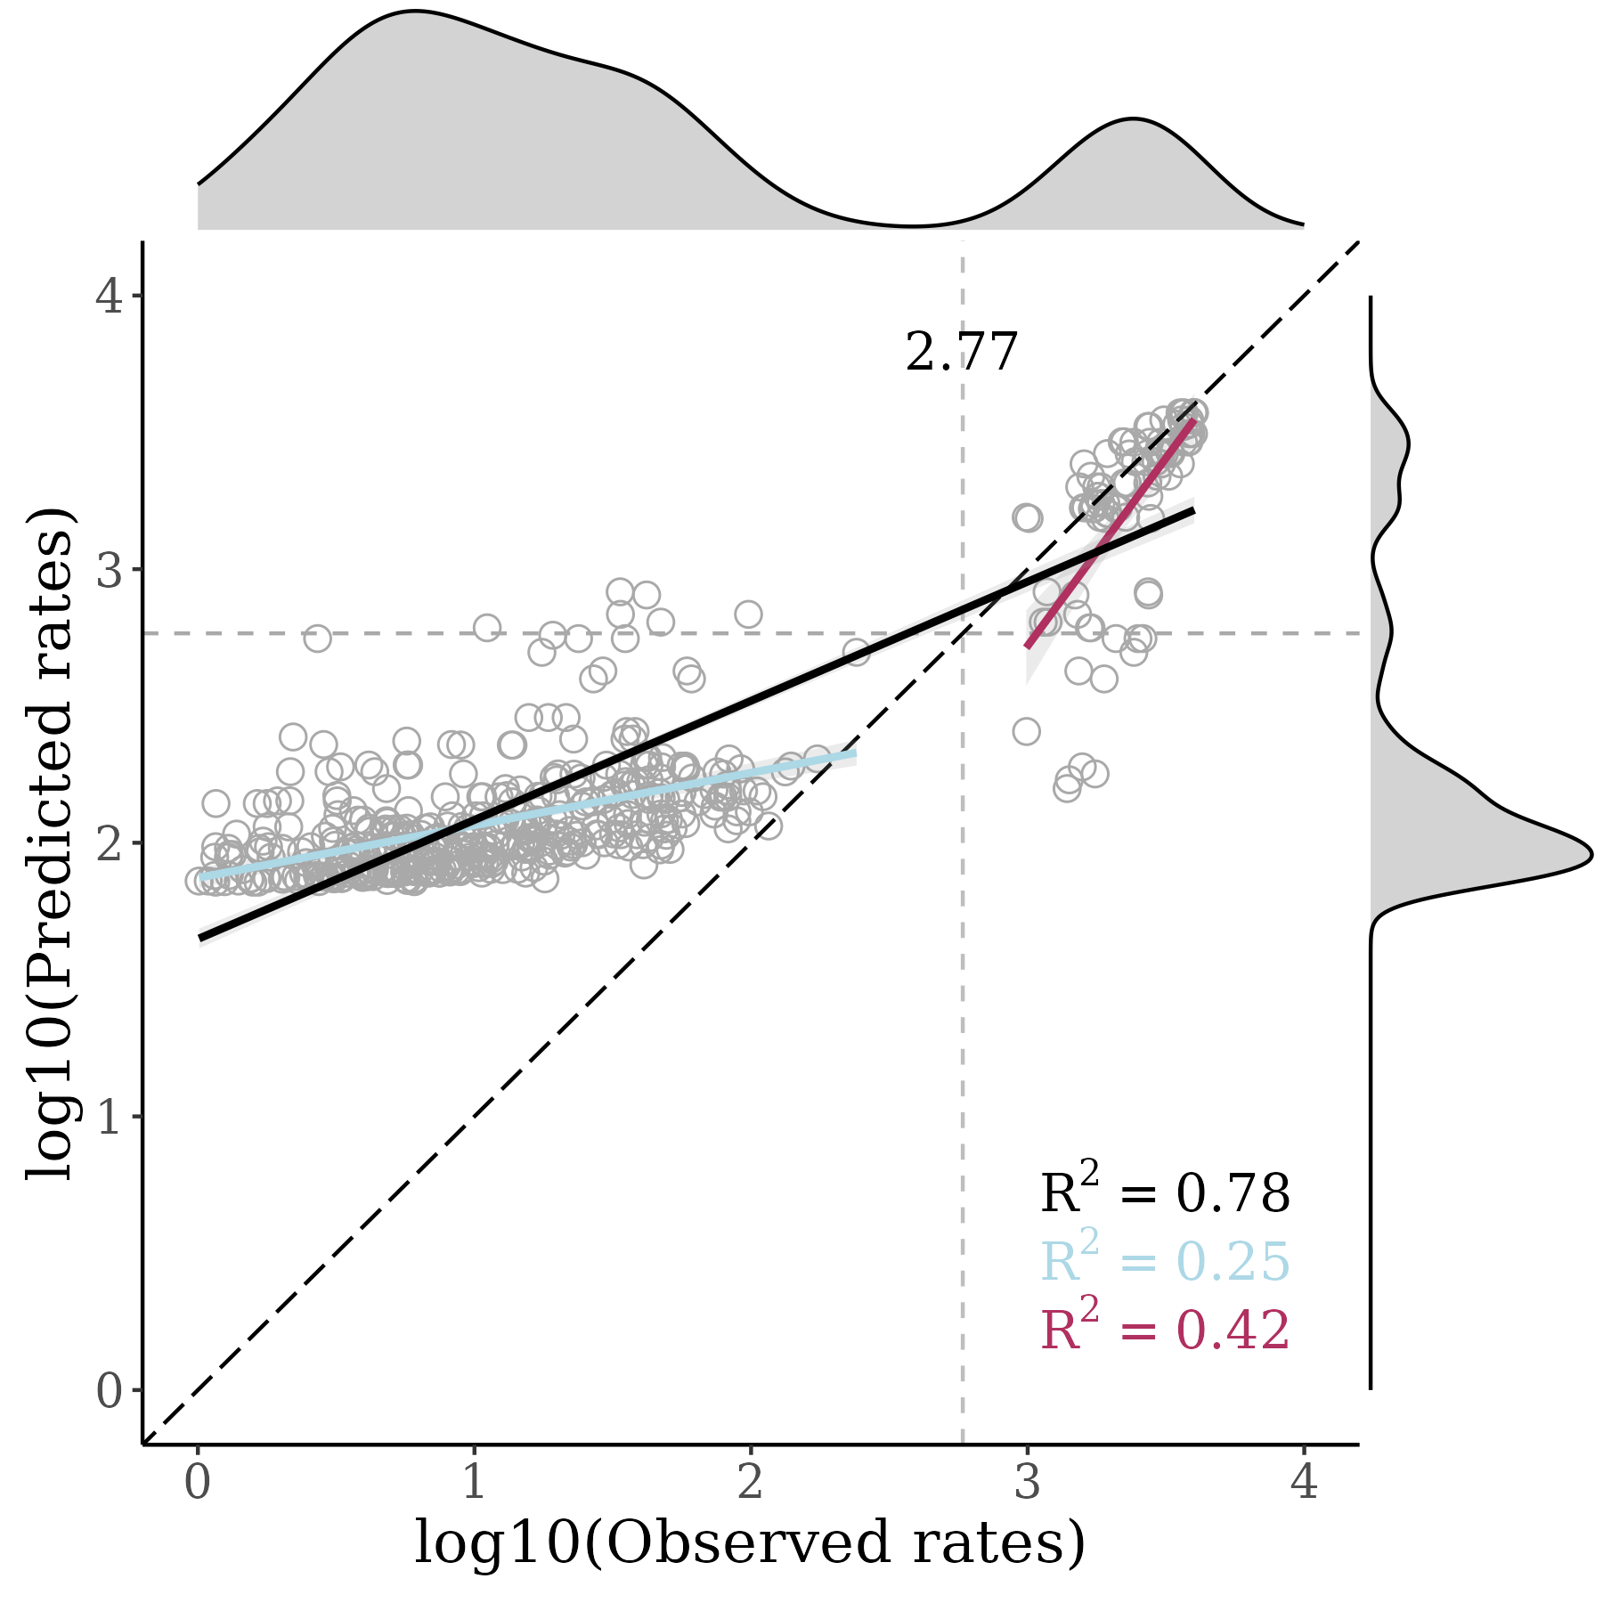

February 2023
SAMPLED SITES
MODEL PERFORMANCE
HIGH PRIORITY SITES

Slide 12

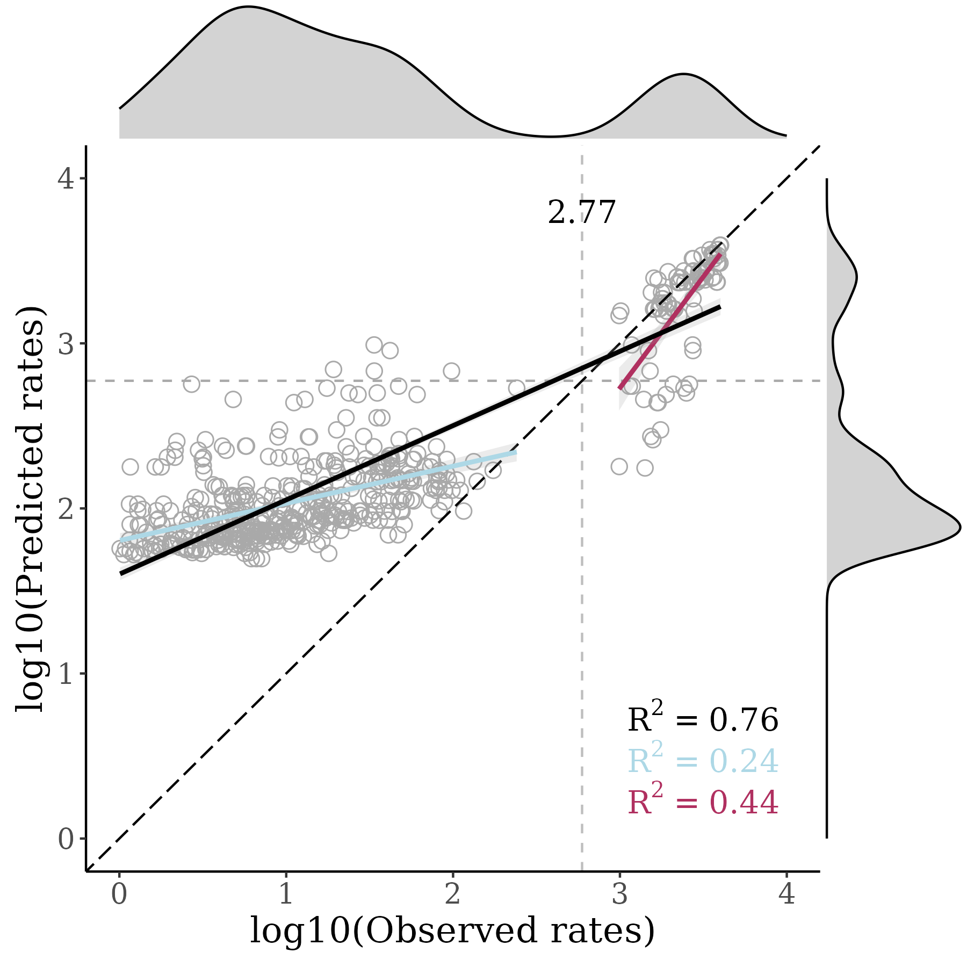
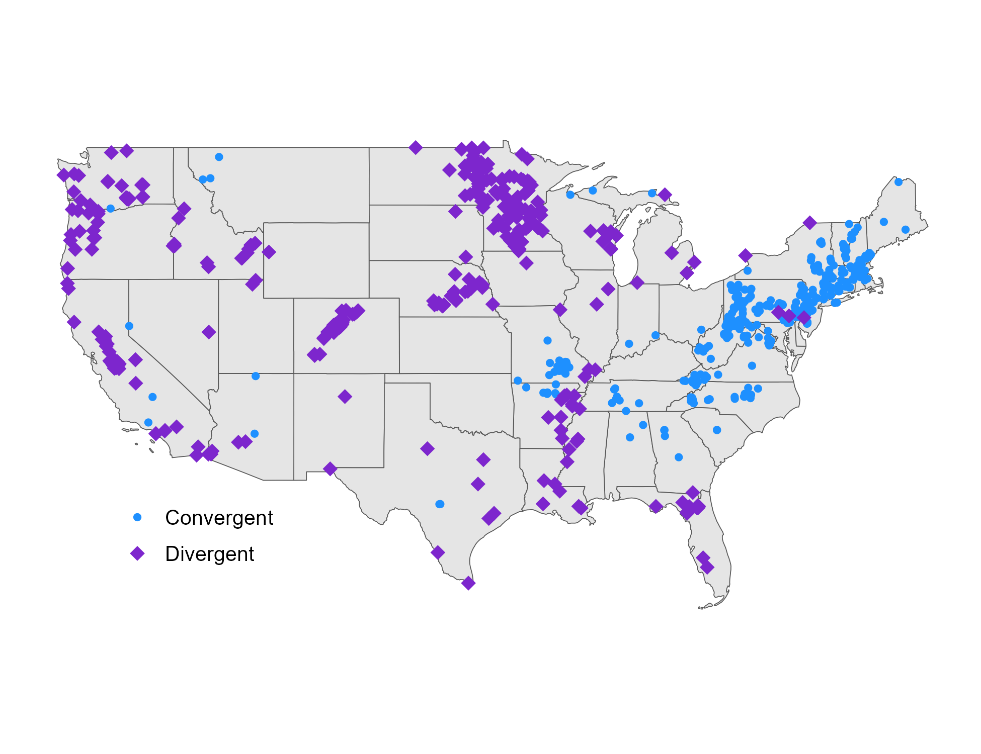
March 2023
SAMPLED SITES
MODEL PERFORMANCE
HIGH PRIORITY SITES

Slide 13

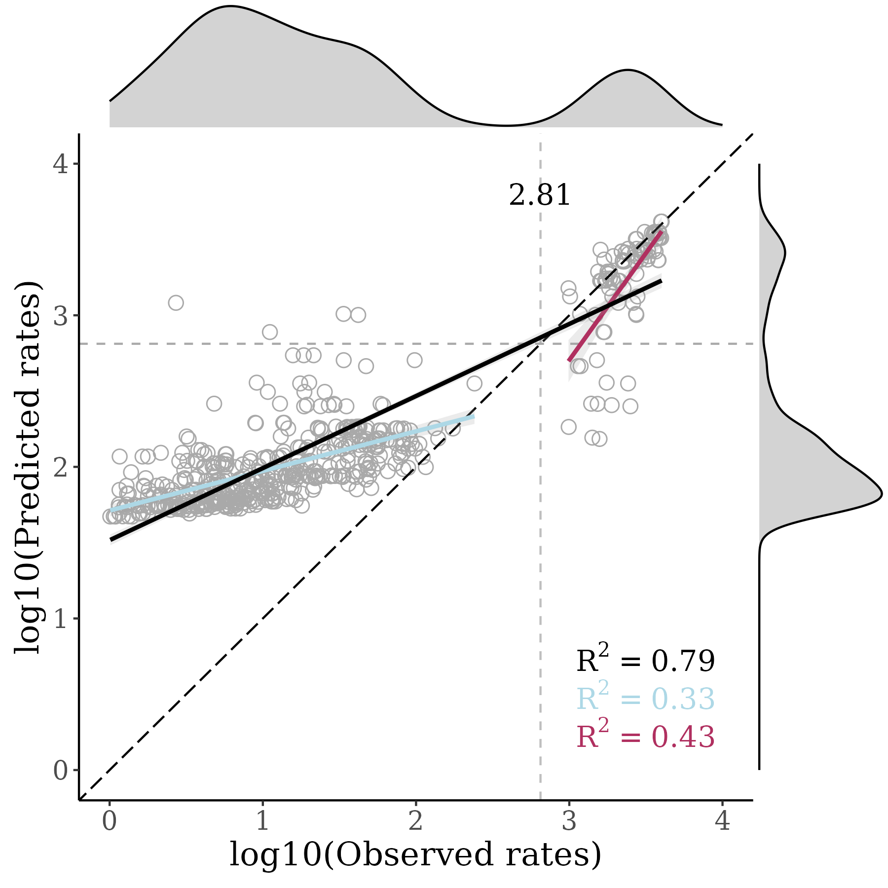

April 2023
SAMPLED SITES
MODEL PERFORMANCE
HIGH PRIORITY SITES

Slide 14

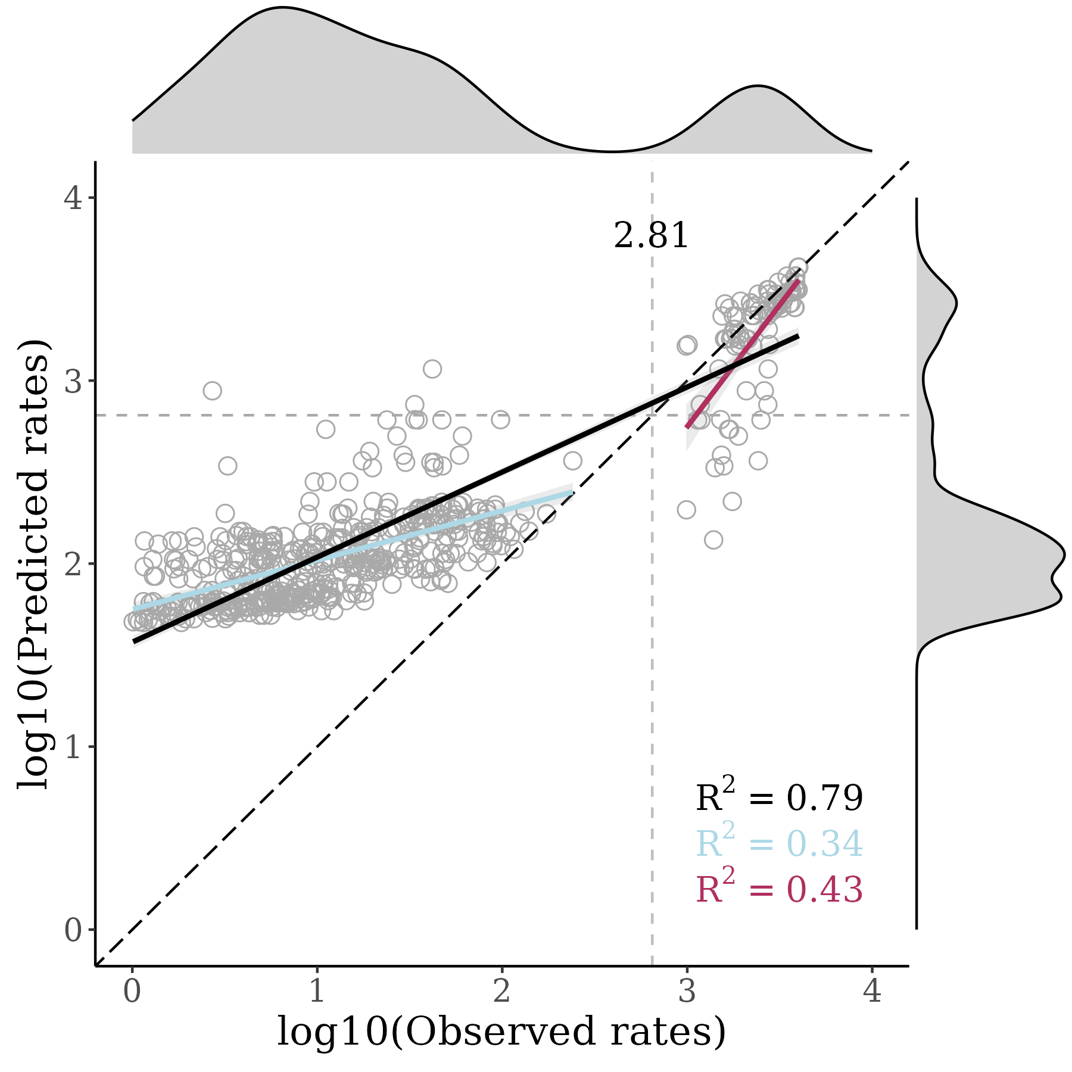

May 2023
SAMPLED SITES
MODEL PERFORMANCE
HIGH PRIORITY SITES

Slide 15

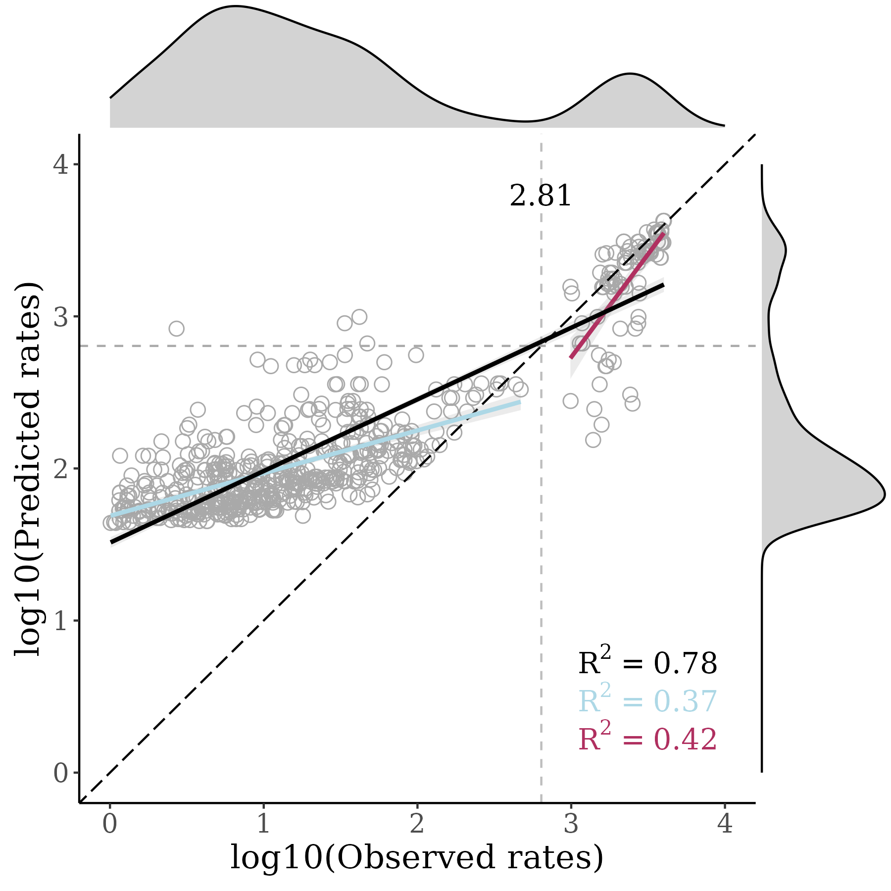
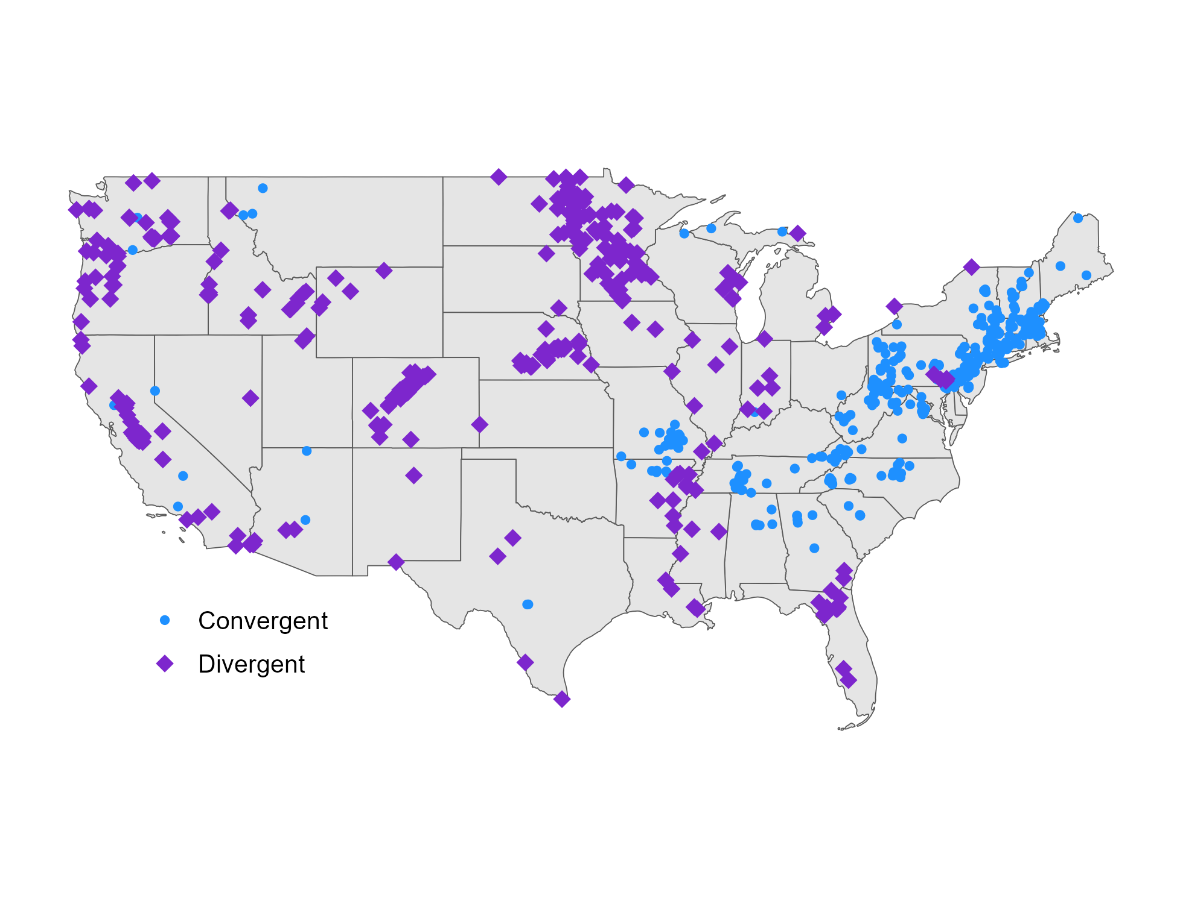
June 2023
SAMPLED SITES
MODEL PERFORMANCE
HIGH PRIORITY SITES

Slide 16

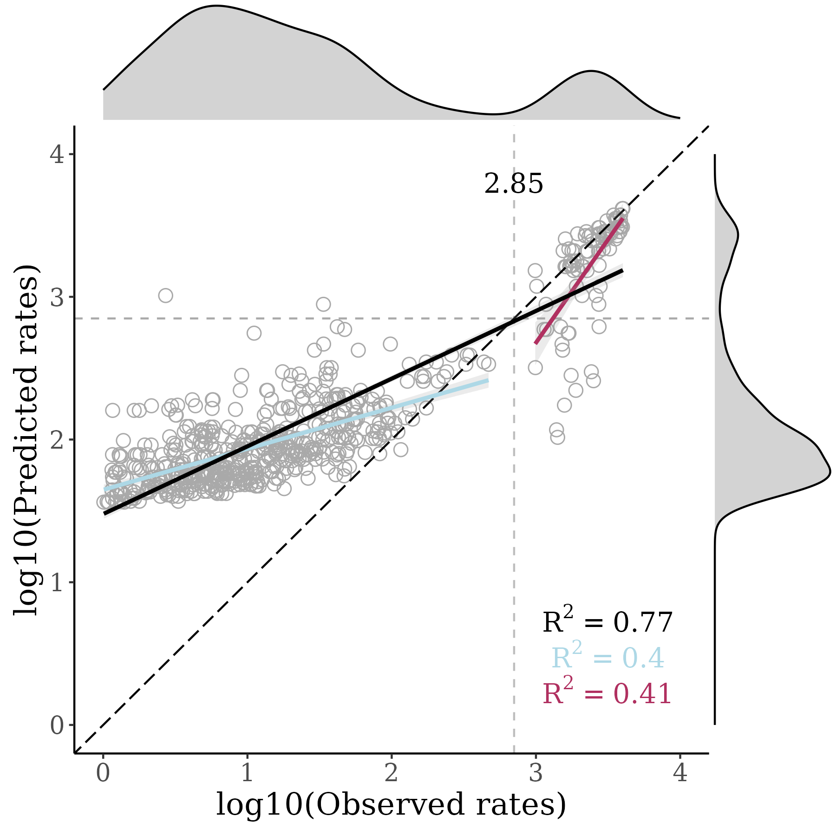
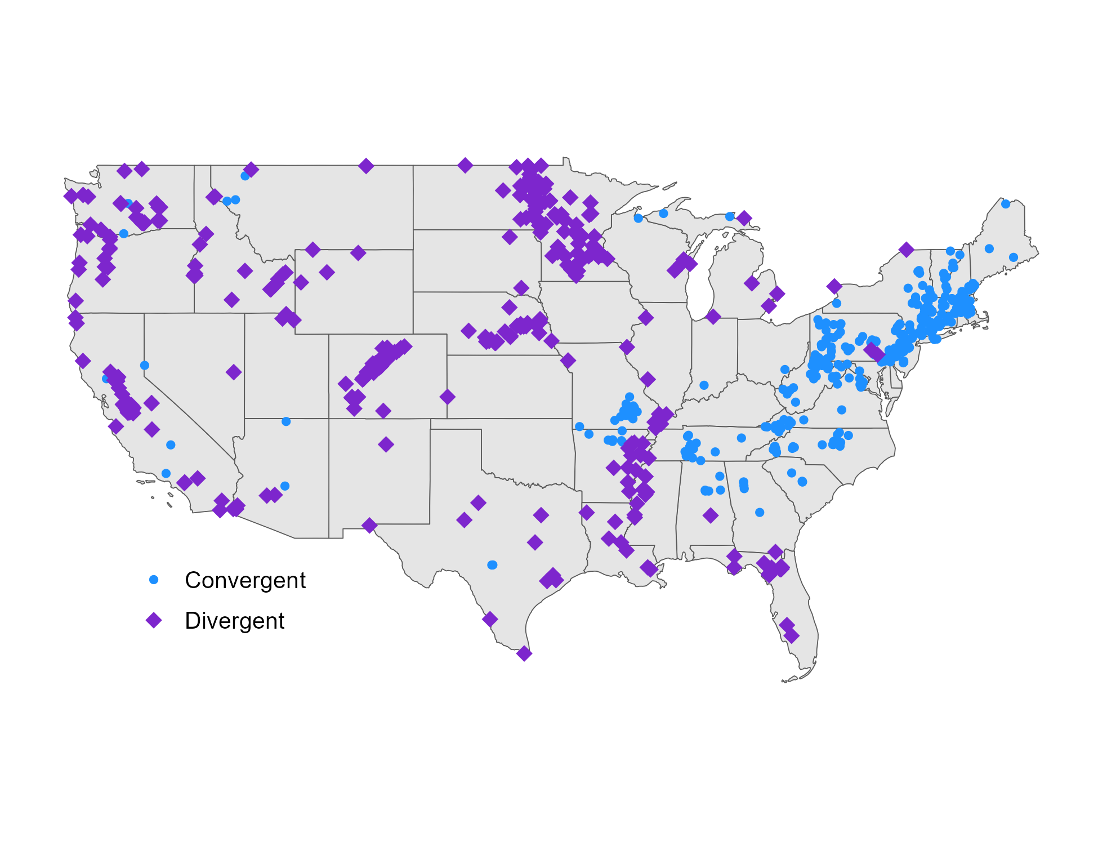
July 2023
SAMPLED SITES
MODEL PERFORMANCE
HIGH PRIORITY SITES

Slide 17

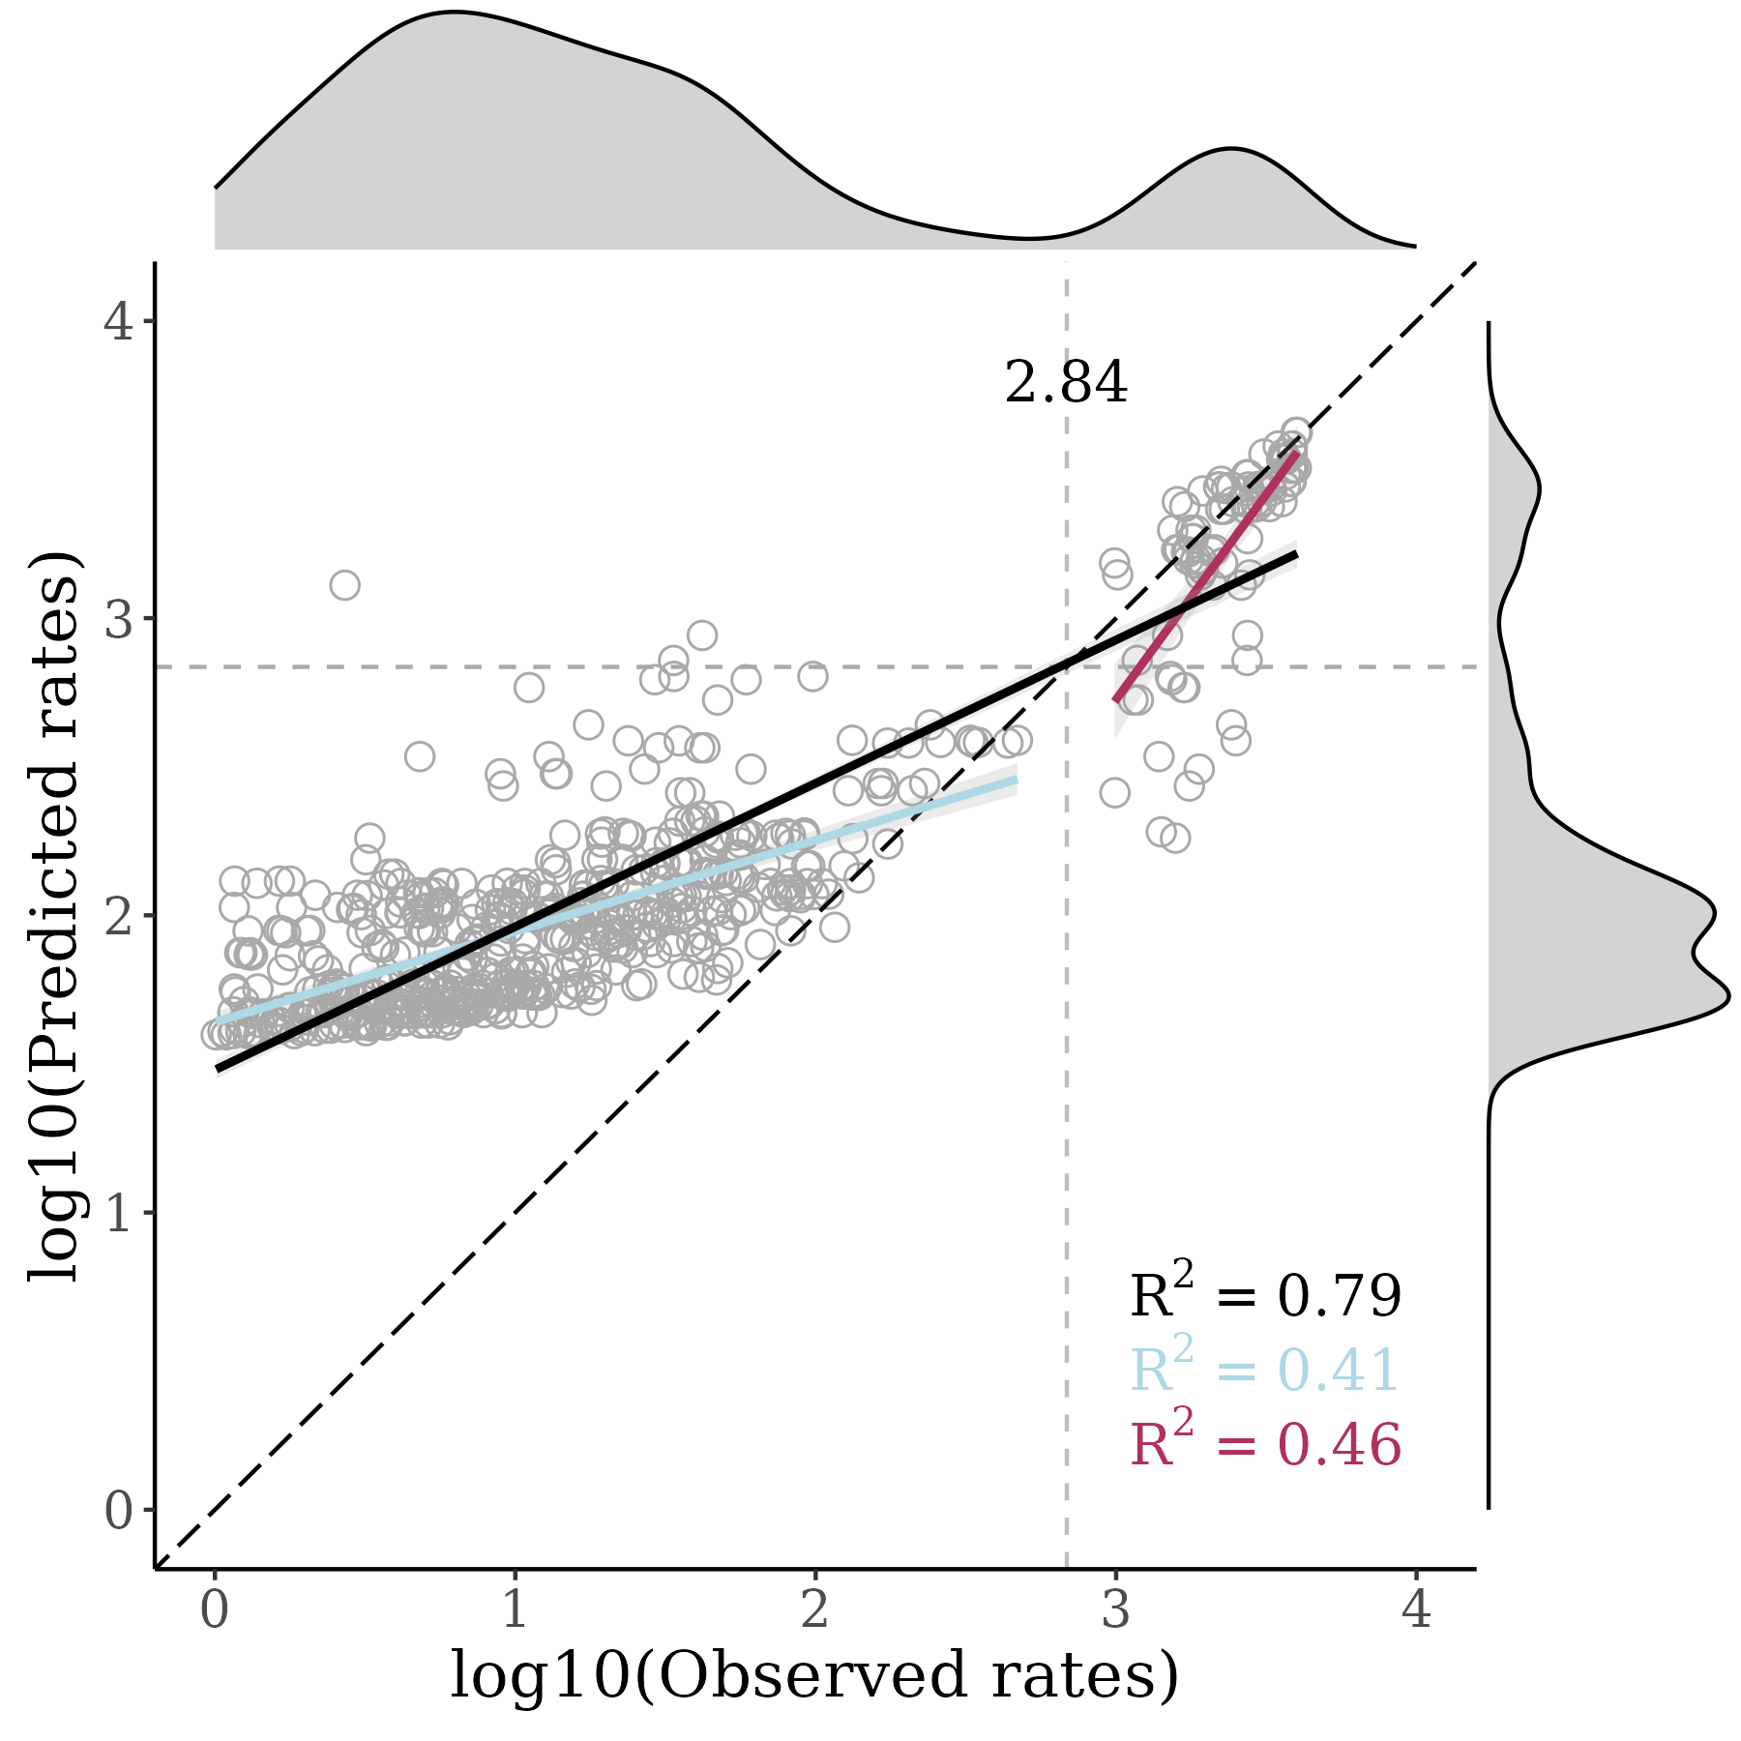

August 2023
SAMPLED SITES
MODEL PERFORMANCE
HIGH PRIORITY SITES

Slide 18

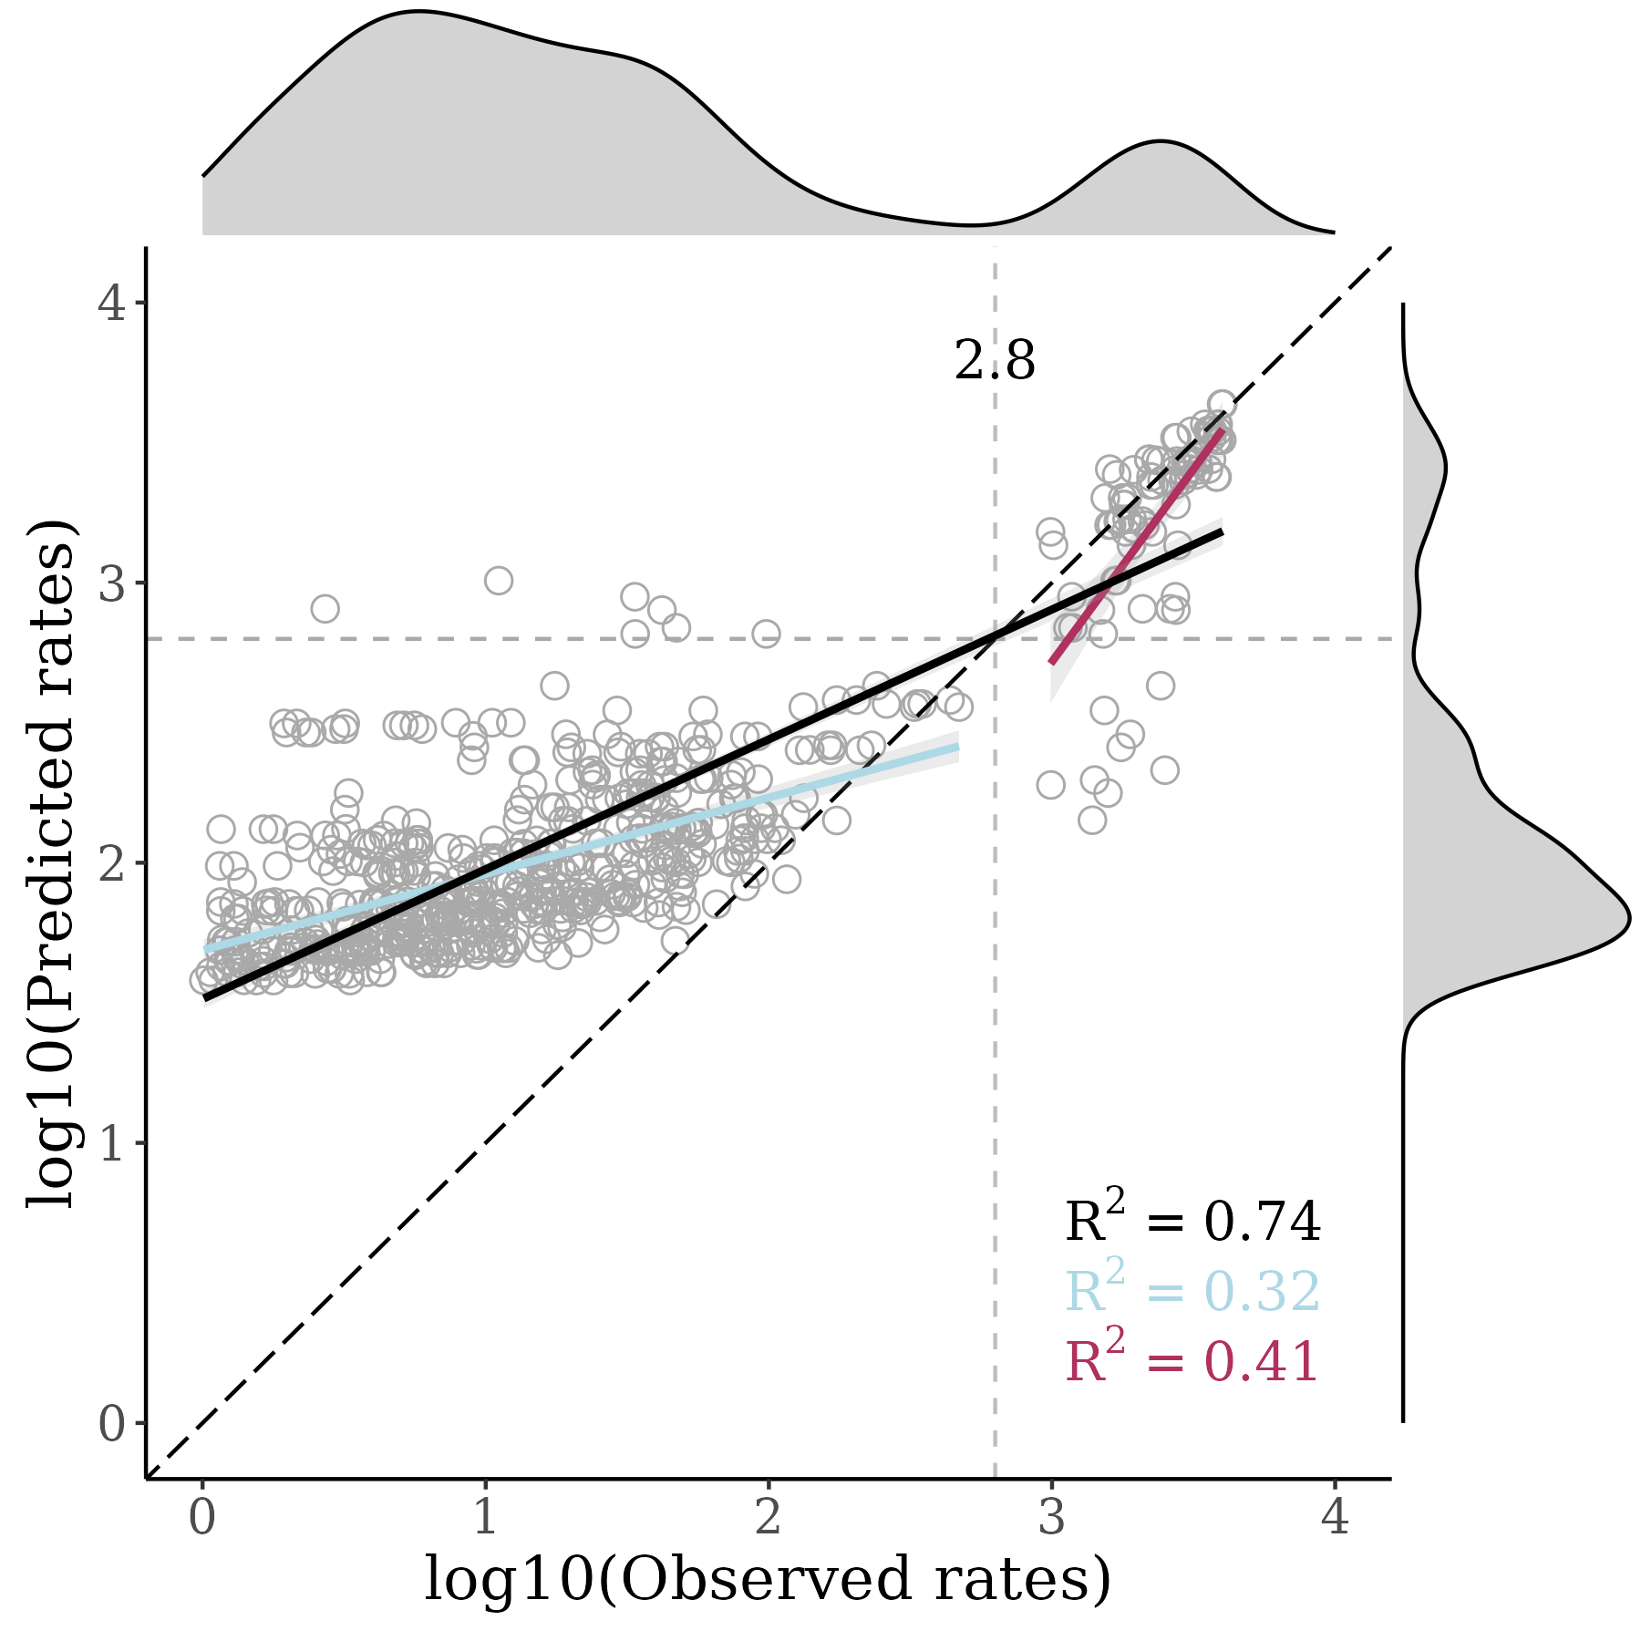
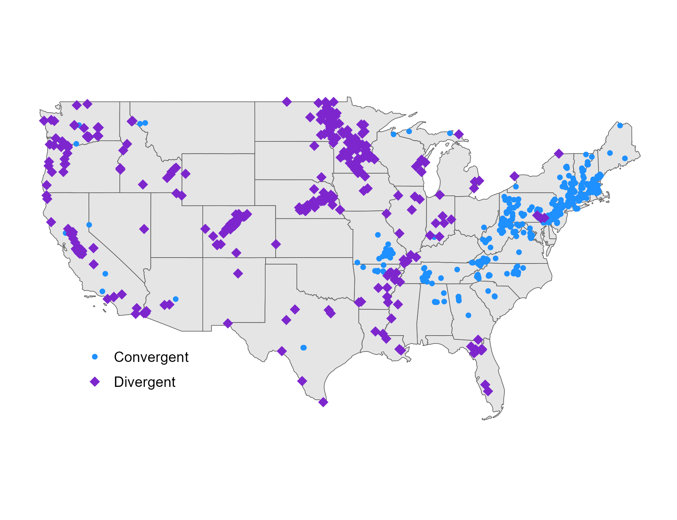
September 2023
SAMPLED SITES
MODEL PERFORMANCE
HIGH PRIORITY SITES

Slide 19

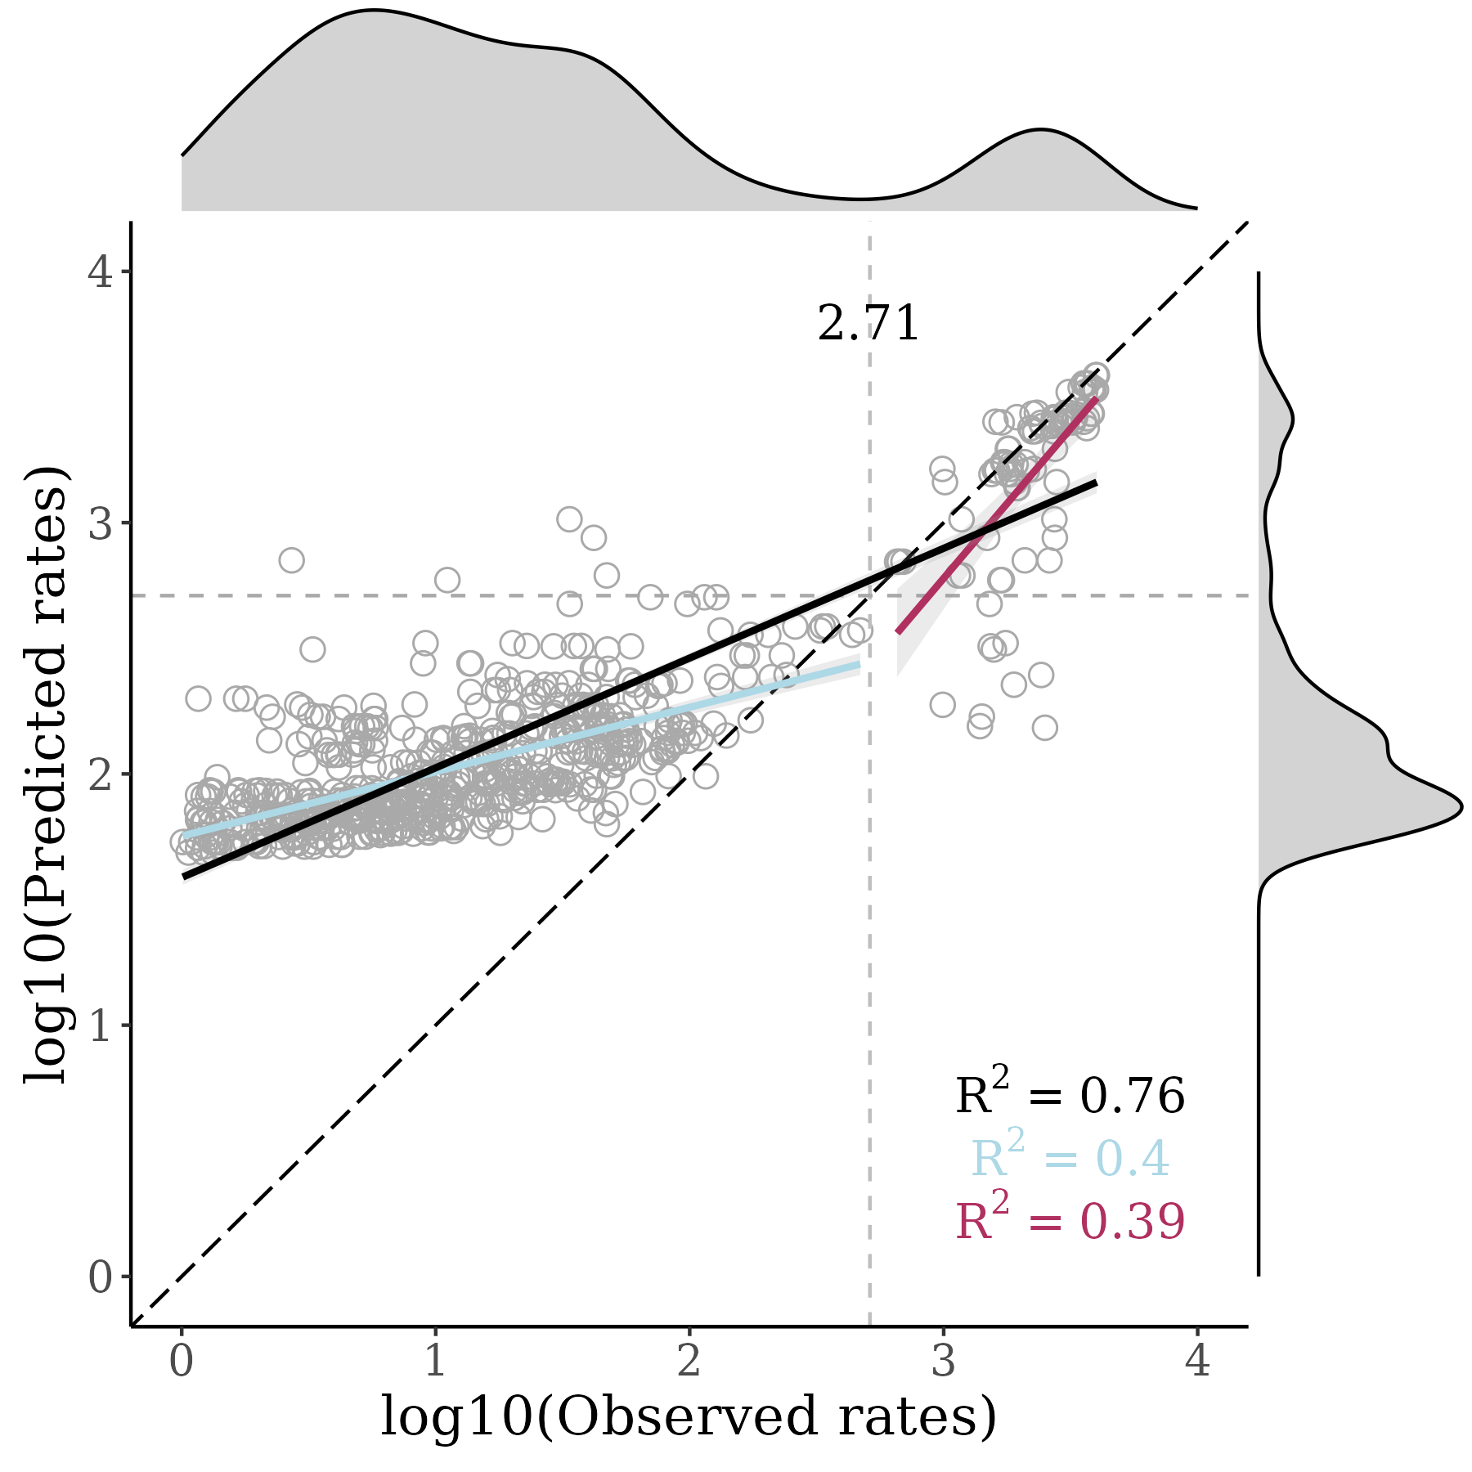

October 2023
SAMPLED SITES
MODEL PERFORMANCE
HIGH PRIORITY SITES

Slide 20

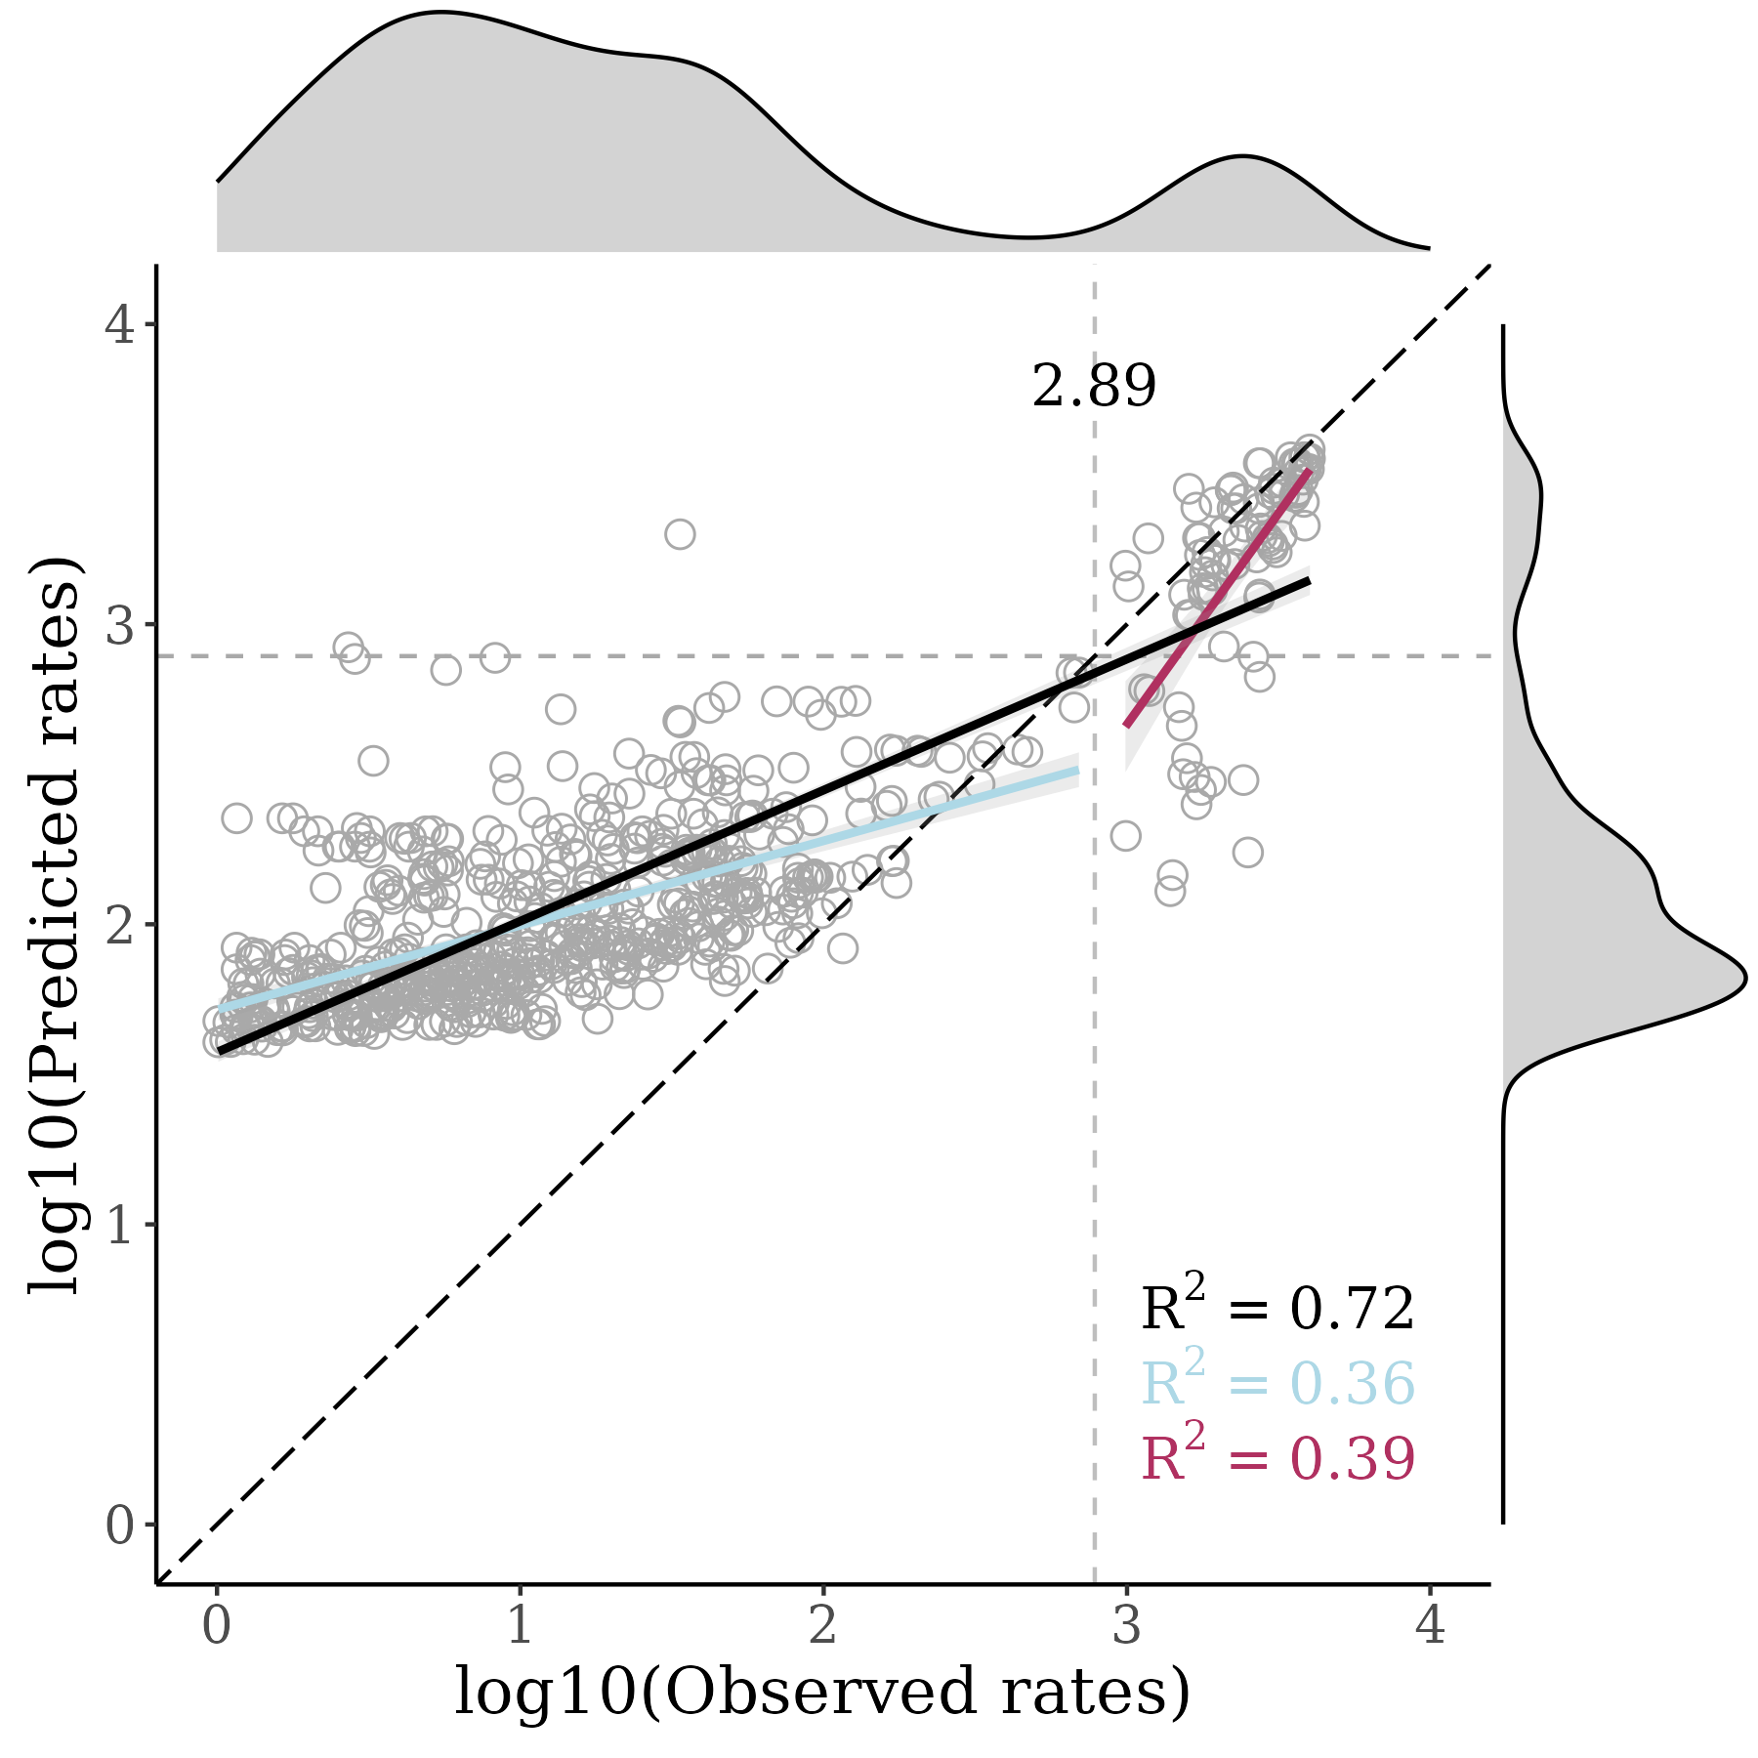

November 2023
SAMPLED SITES
MODEL PERFORMANCE
HIGH PRIORITY SITES

